Slide 1
Introduction to Cloud Computing
Understanding the Foundations of Modern IT Infrastructure

Slide 2

About Me
Md Shahriar Rahman
Software engineer @ OrangeBD
2 years+ industry experience
AWS certified Cloud Practitioner
bdapps National Hackathon Winner - 2022

Slide 3

Introduction to Cloud Computing
Cloud computing is the delivery of on-demand computing services—such as servers, storage, databases, networking and more—over the internet ('the cloud').
Compare cloud computing to utility services like electricity or water on-demand, scalable, and pay-as-you-go

Slide 4
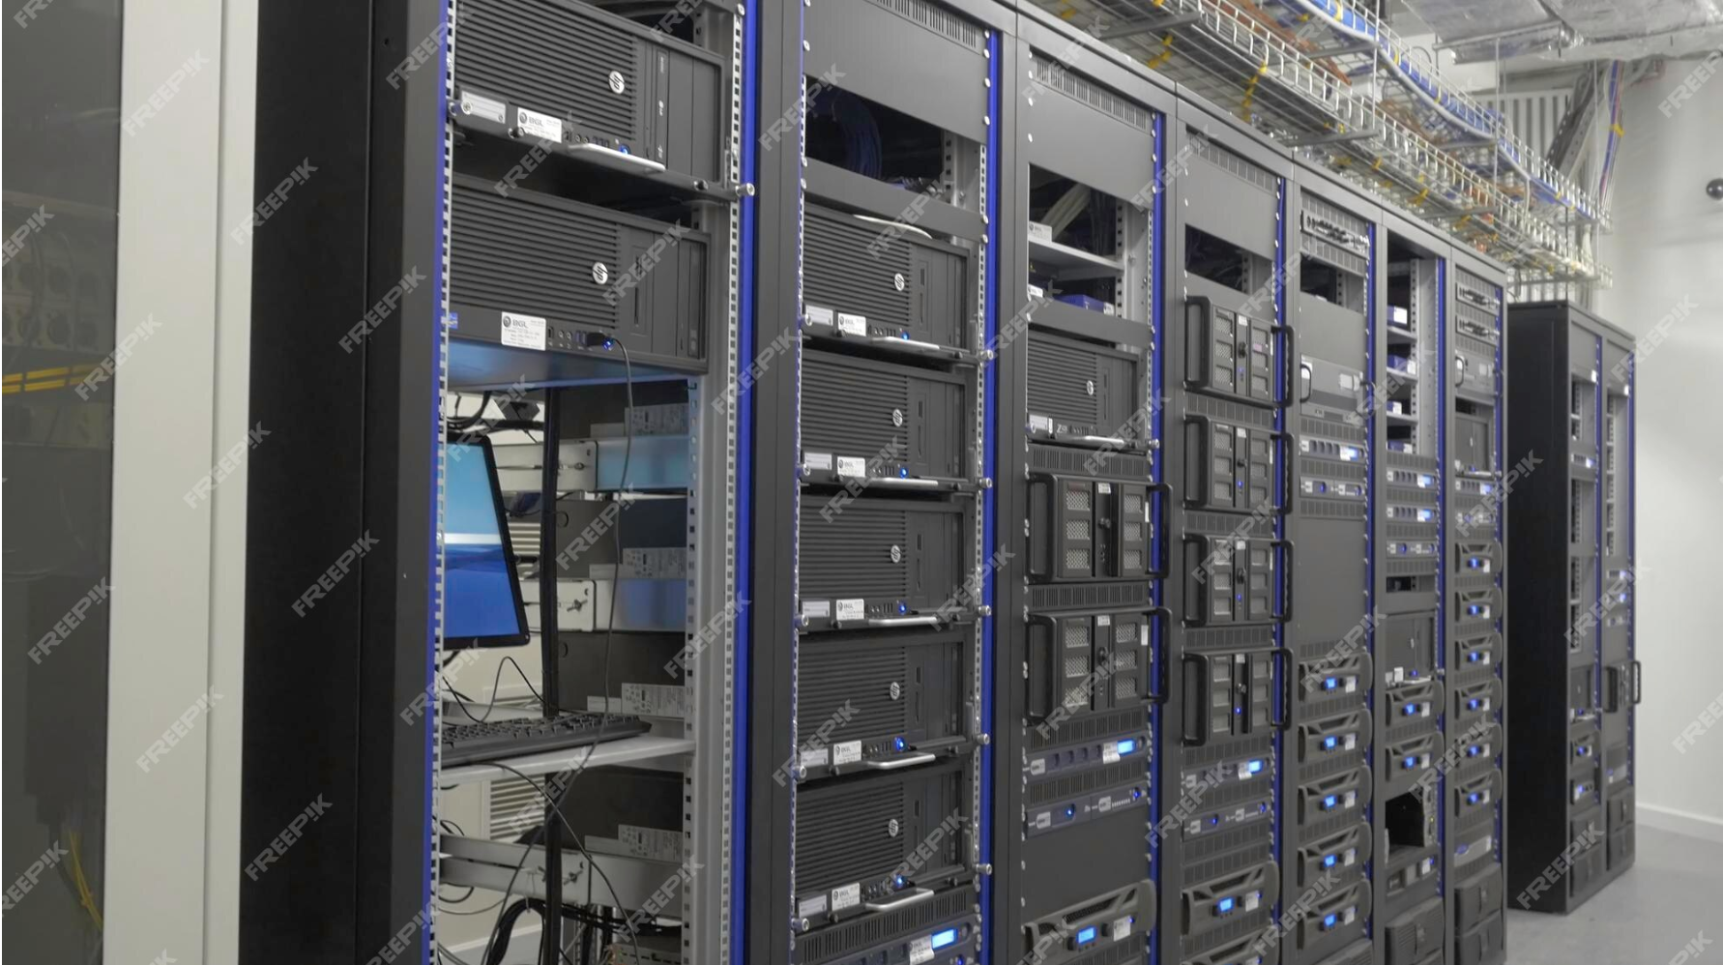
Server in Server Rack

Slide 5
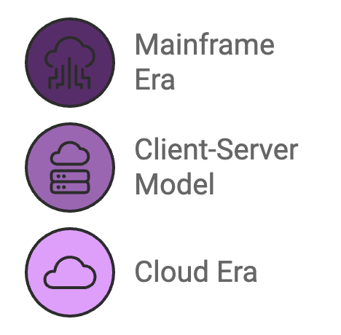
2. Evolution of Computing
Mainframe Era (1950s-1970s): Centralized computing, limited to large organizations.
Client-Server Model (1980s-1990s): Decentralized computing with personal computers and local servers.
Cloud Era (2000s-Present): On-demand, scalable resources available globally, thanks to advances in virtualization, internet speed, and storage.

Slide 6
3. Key Characteristics of Cloud Computing
On-Demand Self-Service: Users can provision resources automatically.
Broad Network Access: Available over the network, accessible from various devices.
Resource Pooling: Multi-tenant model with dynamic allocation.
Rapid Elasticity: Scale up/down based on demand.
Measured Service: Pay only for what you use.

Slide 7
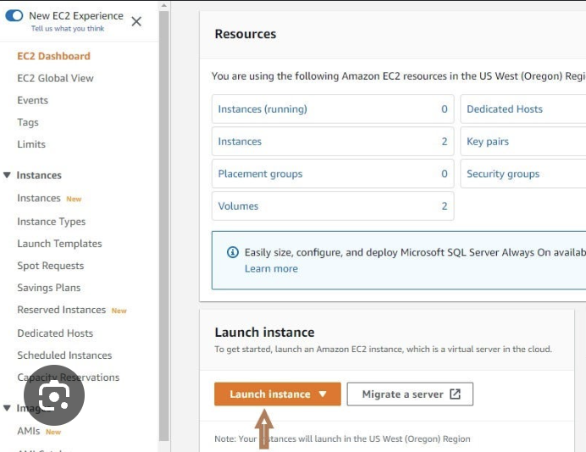
On-Demand Self-Service:
Users can access computing resources like servers and storage automatically, without human interaction with service providers.
Example: Launching a virtual machine (VM) on AWS.

Slide 8
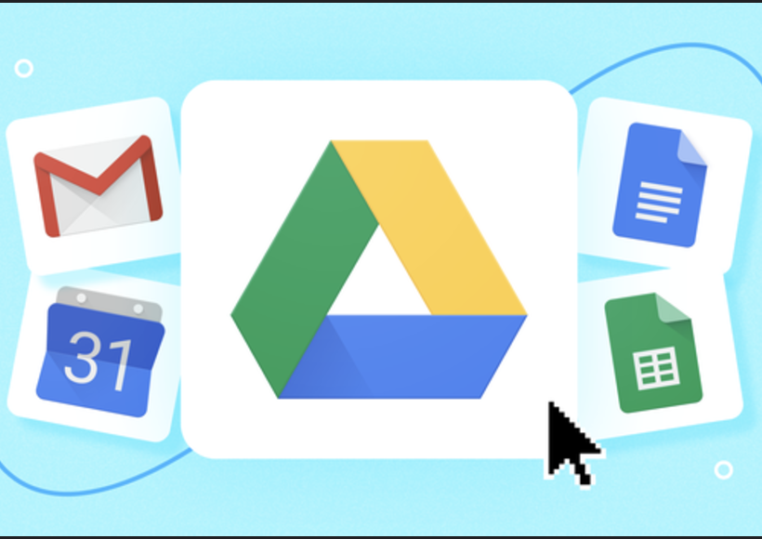
Broad Network Access
Services are accessible over the network via standard devices such as laptops, smartphones, or tablets.
Example: Accessing Google Drive from any device.

Slide 9
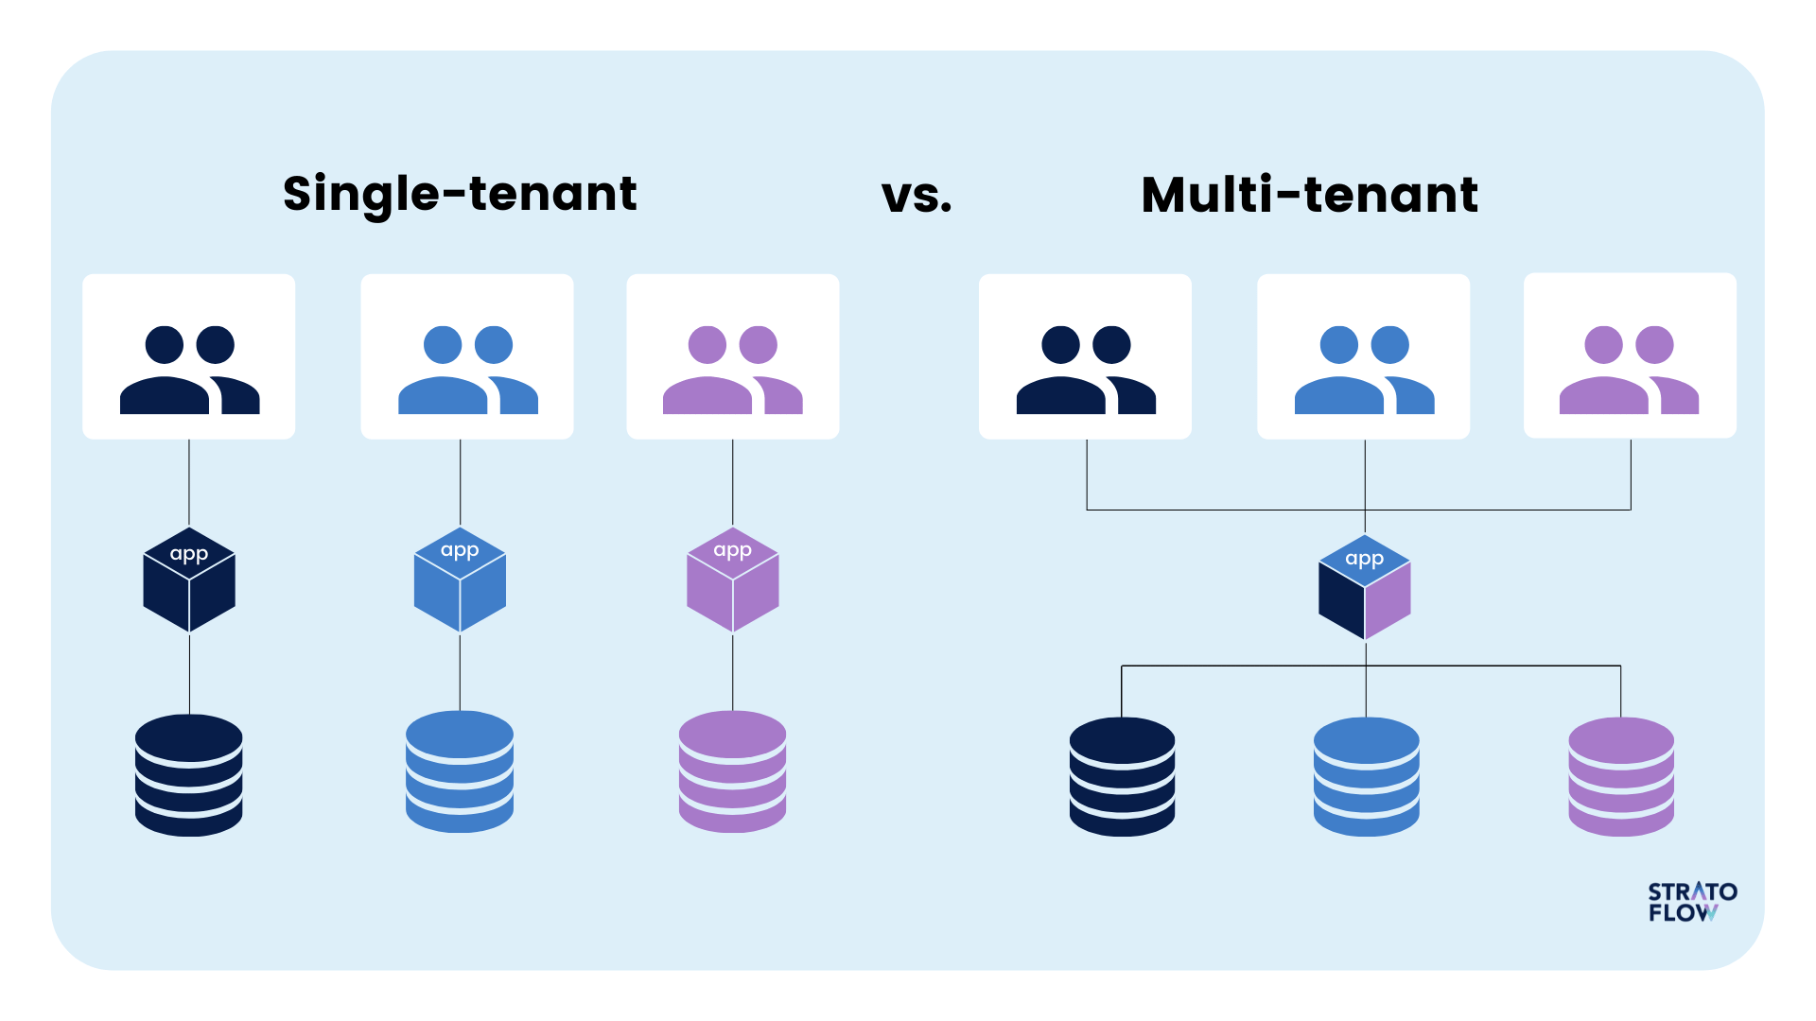
Resource Pooling:
Providers pool resources to serve multiple users using a multi-tenant model. Resources are dynamically assigned.
Example: AWS uses data centers globally to serve customers seamlessly.

Slide 10
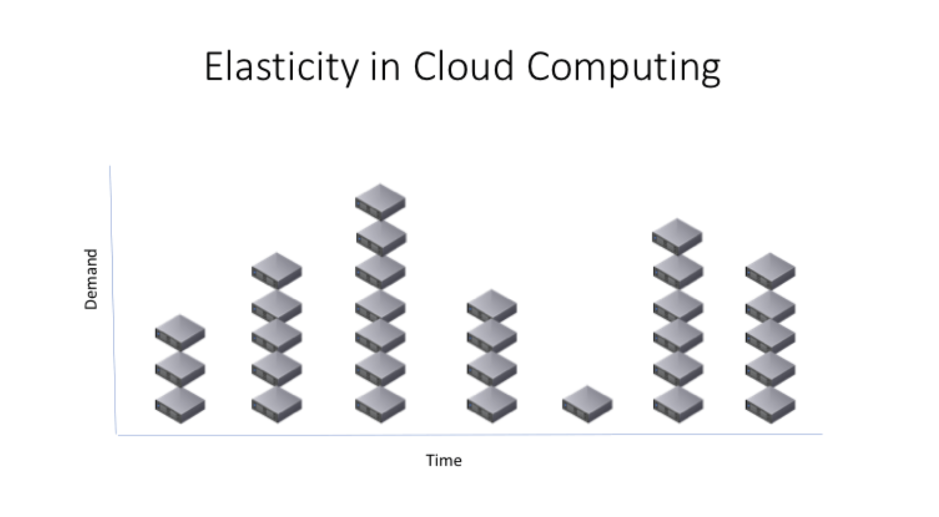
Rapid Elasticity:
Resources can be scaled up or down automatically or manually.
Example: E-commerce platforms scaling up during Eid sales.

Slide 11
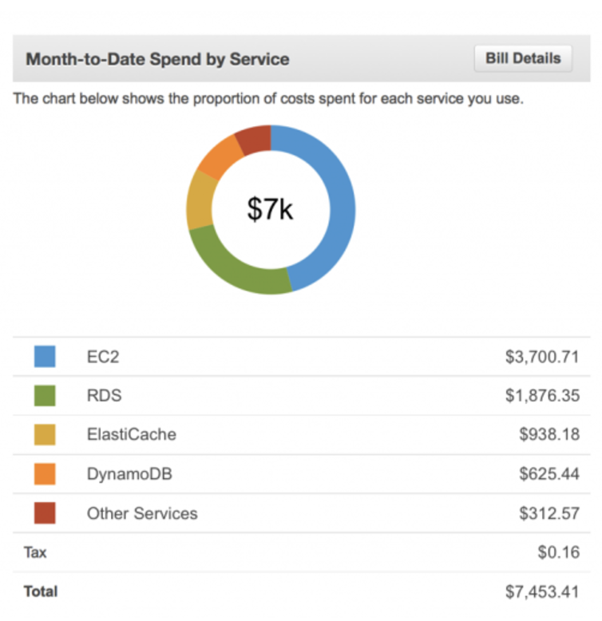
Measured Service:
Cloud systems automatically control and optimize resource usage, providing a metering capability.
Example: AWS bills based on the number of compute hours or storage used.

Slide 12
4. Cloud Service Models
IaaS (Infrastructure as a Service):
Example: AWS EC2, Google Compute Engine
Provides virtualized computing resources (VMs, storage, etc.)
PaaS (Platform as a Service):
Example: AWS Elastic Beanstalk, Google App Engine
Provides a platform for developing, testing, and deploying applications.
SaaS (Software as a Service):
Example: Gmail, Dropbox, Salesforce
Users access software over the internet without managing infrastructure.

Slide 13
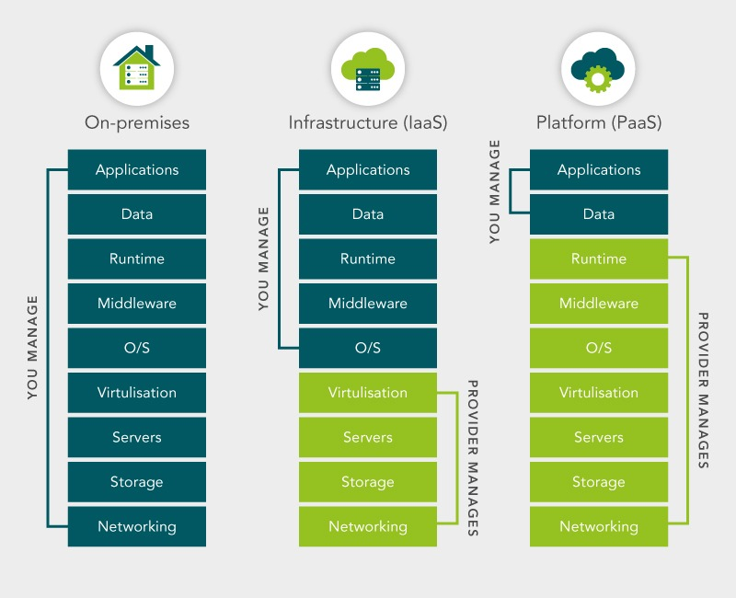
Responsibility Sharing

Slide 14
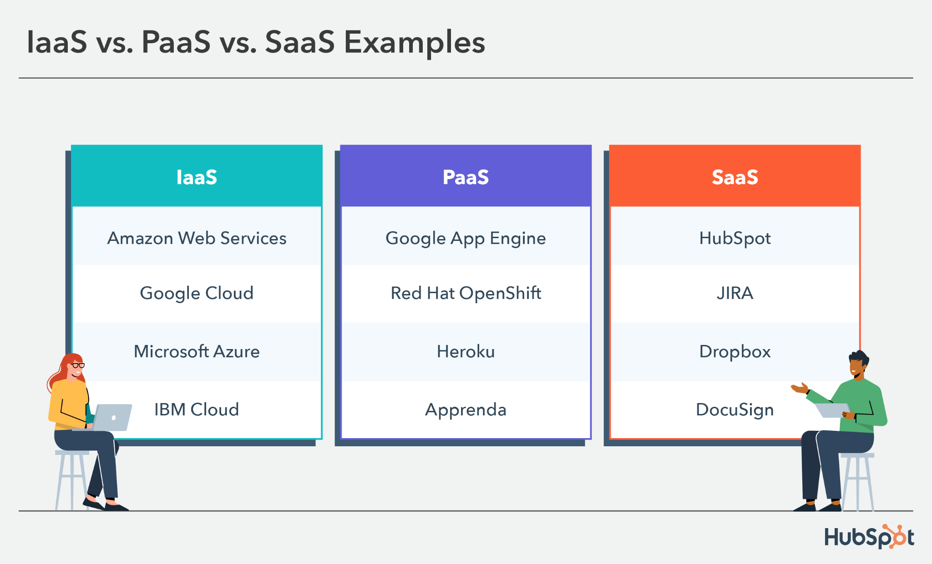

Slide 15
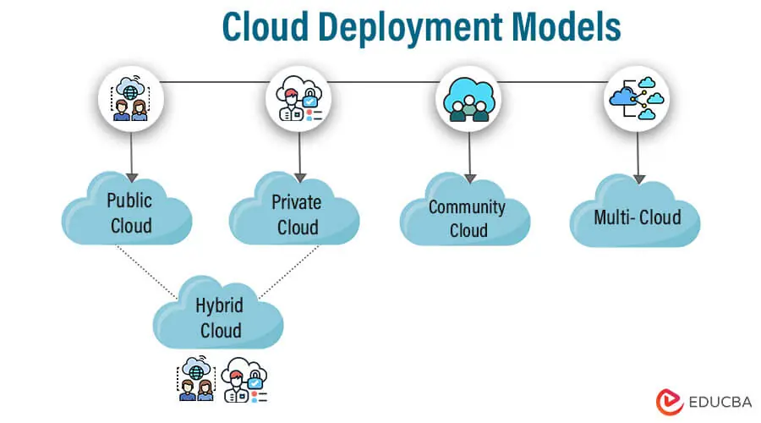
5. Cloud Deployment Models
Public Cloud: Services offered over the internet (e.g., AWS, Azure, GCP).
Private Cloud: Cloud infrastructure dedicated to a single organization.
Hybrid Cloud: Combination of public and private clouds.
Community Cloud: Shared by organizations with a common goal.

Slide 16
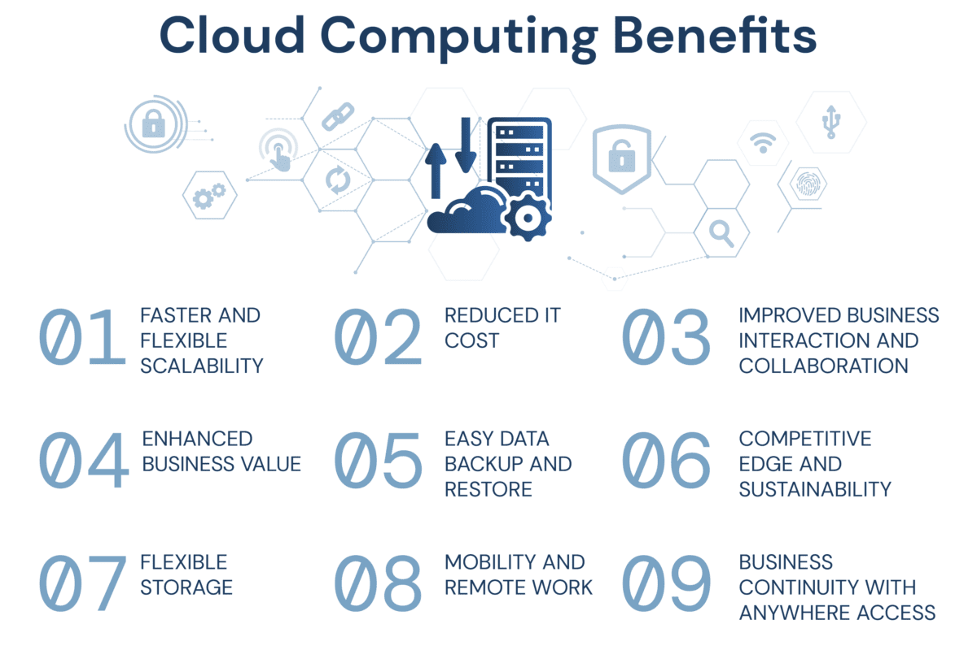
6. Benefits of Cloud Computing
1. Cost efficiency
2. Scalability and elasticity
3. High availability and redundancy
4. Innovation acceleration

Slide 17
7. Challenges in Cloud Computing
Data security and privacy (Cloud did not used in govt project)
Vendor lock-in
Downtime risks

Slide 18
Summary
Cloud computing delivers on-demand IT services over the internet.
Three service models: IaaS, PaaS, SaaS.
Four deployment models: Public, Private, Hybrid, Community.
Benefits include cost efficiency, scalability, and innovation, but challenges like security and vendor lock-in remain.

Slide 19

Thank You
Open for Questions
Connect with me in LinkedIn

Slide 20
Resource Sharing in the Cloud
Characteristics: On-Demand, Pay-as-You-Go, Multi-Tenancy

Slide 21
Objectives for Today’s Class
By the end of this class, students will be able to:
Understand the concept of resource sharing in cloud computing.
Explain the key characteristics of cloud computing: on-demand, pay-as-you-go, and multi-tenancy.
Discuss the advantages and limitations of resource sharing in the cloud.

Slide 22
What is resource in the cloud?
Cloud resources are essential components provided by cloud platforms to build, deploy, and manage applications. They include:
Compute Resources: Virtual Machines (VMs), Containers, Serverless (e.g., AWS Lambda, Azure VMs).
Storage Resources: Object, Block, and File Storage (e.g., AWS S3, Azure Blob).
Networking Resources: Virtual Private Cloud (VPC), Load Balancers, DNS.
Database Resources: Relational (SQL) and NoSQL Databases (e.g., AWS RDS, DynamoDB).
Security & IAM: Access control, Encryption (e.g., AWS IAM, Azure Key Vault).
Monitoring & Logging: Performance tracking, log analysis (e.g., AWS CloudWatch).
Development Tools: CI/CD, API Gateways (e.g., AWS CodePipeline, Azure API Gateway).

Slide 23
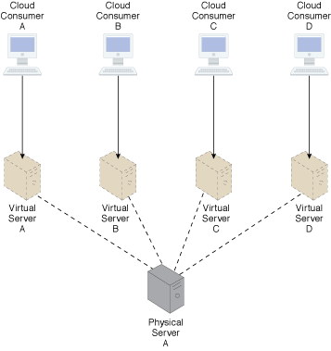
What is Resource Sharing in the Cloud?
Resource sharing in cloud computing refers to the ability to allocate and manage computing resources dynamically among multiple users, ensuring optimal usage.
Example: Multiple users sharing the same physical server but each running their own isolated virtual machine.

Slide 24
Key Characteristics of Cloud Resource Sharing
On-Demand Self-Service: Users can provision resources automatically.
Broad Network Access: Available over the network, accessible from various devices.
Resource Pooling: Providers pool computing resources to serve multiple consumers using a multi-tenant model

Slide 25
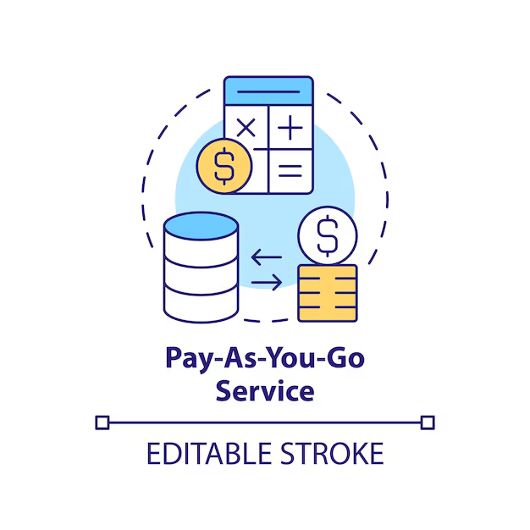
Pay-as-You-Go Model
Cloud users are charged based on their usage of resources rather than a fixed upfront cost.
Benefits:
Cost efficiency: Pay only for what you use.
Flexibility: Scale resources up or down according to need.
Example: AWS charges for storage (S3) based on the amount of data stored and transferred.

Slide 26
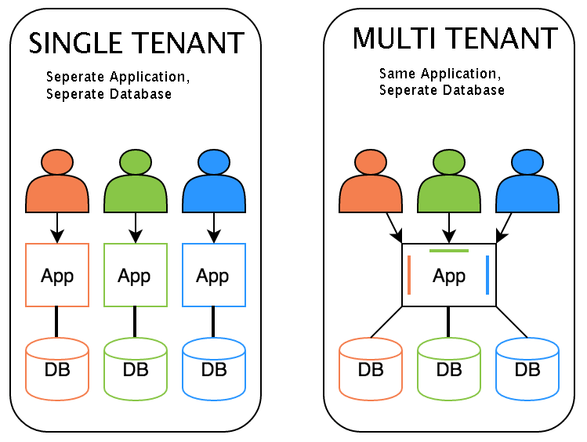
Multi-Tenancy in Cloud Computing
Multi-tenancy allows multiple customers (tenants) to share the same infrastructure while maintaining data isolation.
Key Benefits:
Efficient resource utilization.
Reduced cost per user.
Example: Salesforce provides a single instance of its CRM application to multiple companies.

Slide 27
Advantages of Resource Sharing
Cost Savings: Reduces the need for physical hardware and maintenance.
Scalability: Easily adjust resource allocation based on demand.
High Availability: Redundant (অপ্রয়োজনীয়) resources ensure system uptime and reliability.
Increased Collaboration: Teams can access shared resources and work seamlessly.

Slide 28
Challenges of Resource Sharing
Data Security Risks: Potential exposure of data in shared environments.
Performance Issues: Resource contention can occur if many users need resources simultaneously.
Compliance Issues: Ensuring regulatory compliance (e.g., GDPR) in shared environments.
Vendor Lock-in: Dependence on a single cloud provider can limit flexibility.

Slide 29
Case Study: Netflix on AWS
Scenario: Netflix uses AWS to stream content globally to millions of users.
Resource Sharing: Netflix dynamically scales its resources during peak viewing times.
Outcome: Efficient resource allocation ensures high availability and uninterrupted streaming.

Slide 30
Summary
Resource sharing in cloud computing enables efficient use of computing resources by pooling them across multiple users.
Key characteristics include on-demand self-service, pay-as-you-go, and multi-tenancy.
While it offers scalability and cost efficiency, it also poses challenges related to security and performance.

Slide 31
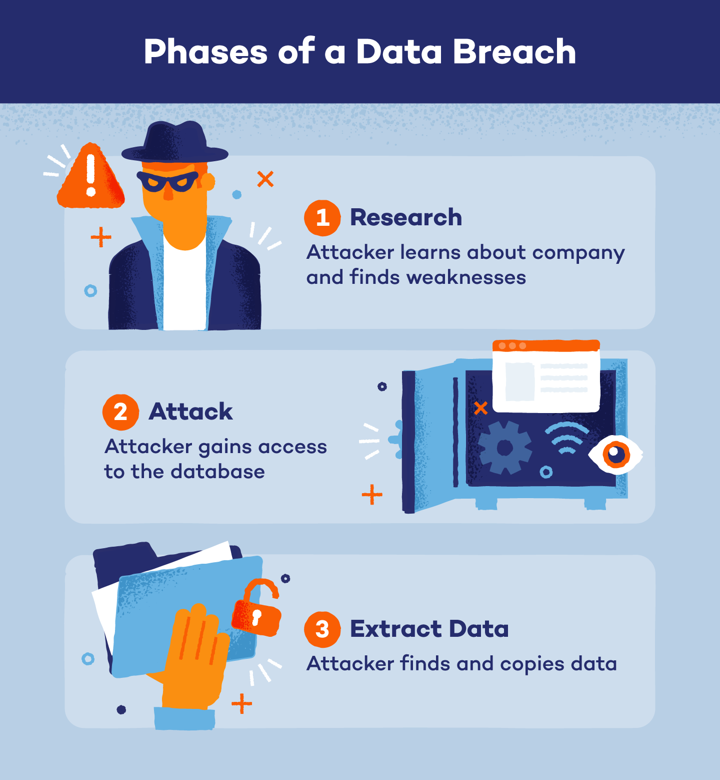
Next Class: Challenges and Risks in Cloud Computing
Discussion on data breaches, vendor lock-in, and regulatory compliance.

Slide 32
Challenges and Risks in Cloud Computing
Vendor Lock-in, Downtime, Data Privacy

Slide 33
Objectives
By the end of this class, we will be able to:
Identify the main challenges and risks associated with cloud computing.
Explain key issues like vendor lock-in, downtime, and data privacy.
Discuss strategies to mitigate these risks in cloud environments.

Slide 34
Overview of Challenges and Risks
Cloud Challenges:
Vendor Lock-in
Downtime and Availability
Data Privacy and Security
Compliance and Regulatory Issues
Performance and Latency
Cost Management

Slide 35
Vendor Lock-in
Definition: Difficulty in migrating from one cloud provider to another due to proprietary services, APIs, or data formats.
Impact: Limited flexibility and higher switching costs.
Example: AWS Lambda’s proprietary functions can make it difficult to migrate to Azure Functions.
Mitigation Strategies:
Use open standards and interoperable services.
Implement multi-cloud strategies to avoid dependence on a single vendor.

Slide 36
2. Downtime and Availability
Definition: Periods when cloud services are unavailable, leading to disruptions in business operations.
Real-World Example: AWS outage in 2020 impacted major platforms like Netflix, Slack, and Twitch.
Mitigation Strategies:
Utilize multiple availability zones or regions.
Implement failover and disaster recovery solutions.
Use Service Level Agreements (SLAs) to ensure uptime guarantees.

Slide 37
3. Data Privacy and Security Risks
Key Issues:
Unauthorized access to sensitive data.
Data breaches due to misconfigured storage (e.g., S3 buckets).
Insider threats and vulnerabilities in multi-tenant environments.
Mitigation Strategies:
Implement robust encryption for data at rest and in transit.
Use multi-factor authentication (MFA) and Identity and Access Management (IAM).
Regularly audit and monitor for unusual activities.

Slide 38
4. Compliance and Regulatory Challenges
Overview: Ensuring cloud services comply with legal regulations like GDPR, HIPAA, and PCI-DSS.
Challenges:
Data sovereignty: Where data is stored and processed.
Meeting industry-specific compliance requirements.
Mitigation Strategies:
Choose cloud providers that offer compliance certifications.
Understand the shared responsibility model for cloud compliance.

Slide 39
5. Performance and Latency Issues
Definition: Delays in data processing and delivery due to geographical distances and network limitations.
Impact: Affects user experience in latency-sensitive applications like video streaming and gaming.
Mitigation Strategies:
Use Content Delivery Networks (CDNs) to cache data closer to users.
Optimize application architecture for cloud environments.

Slide 40
6. Cost Management Challenges
Key Issues:
Unpredictable costs due to dynamic resource scaling.
Overspending on unused or underutilized resources.
Mitigation Strategies:
Implement cost monitoring tools like AWS Cost Explorer or Azure Cost Management.
Use reserved instances or savings plans for predictable workloads.
Regularly review and optimize resource allocation.

Slide 41
Real-World Case Study
Case: Capital One Data Breach (2019)
Incident: Misconfigured firewall exposed sensitive customer data on AWS.
Impact: Data breach affected over 100 million customers.
Lessons Learned:
Importance of proper configuration and continuous monitoring.
Need for comprehensive security policies in cloud environments.

Slide 42
Summary of Key Points
Cloud Challenges and Risks: Vendor lock-in, downtime, data privacy, compliance, and cost management.
Effective mitigation strategies include multi-cloud adoption, robust security measures, cost control, and using open standards.
Understanding and planning for these challenges are essential for successful cloud adoption.

Slide 43
Next Class Preview
Next Topic: Cloud Service Models (IaaS, PaaS, SaaS)
Deep dive into infrastructure, platform, and software services.

Slide 44
Cloud Service Models
Understanding IaaS, PaaS, and SaaS

Slide 45
Introduction to Cloud Service Models
Definition:
Service models define how cloud services are delivered to users, based on the level of control and management responsibility.
Key Service Models:
Infrastructure as a Service (IaaS)
Platform as a Service (PaaS)
Software as a Service (SaaS)

Slide 46
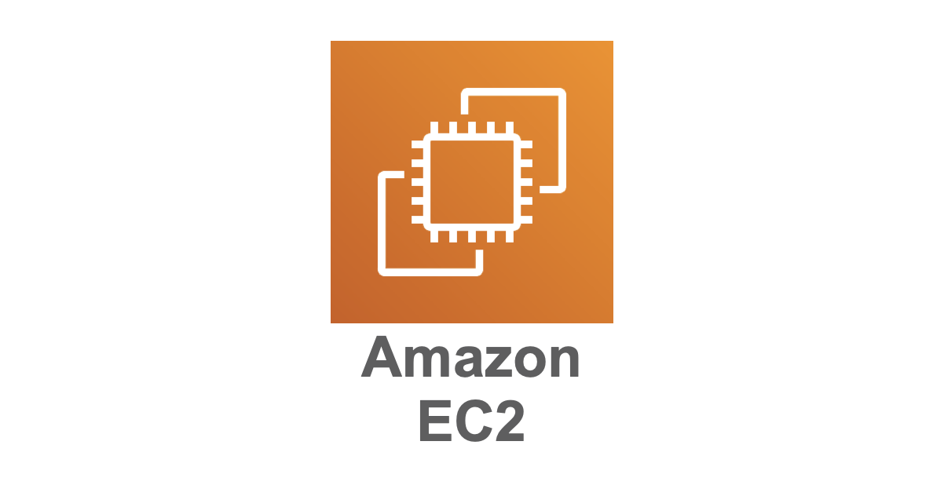
1. Infrastructure as a Service (IaaS)
Provides virtualized computing resources over the internet.
Users manage operating systems, applications, and data while the cloud provider manages hardware and virtualization.
Examples:
Amazon Web Services (AWS) EC2
Google Compute Engine
Microsoft Azure Virtual Machines
Key Features:
Virtual machines, storage, and networks.
High flexibility and scalability.

Slide 47
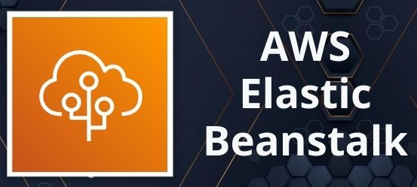
2. Platform as a Service (PaaS)
Provides a platform that allows developers to build, test, deploy, and manage applications without worrying about the underlying infrastructure.
The cloud provider manages OS, runtime, and middleware.
Examples:
Google App Engine
Microsoft Azure App Service
AWS Elastic Beanstalk
Heroku
Key Features:
Simplifies development and deployment.
Ideal for application development without infrastructure management.

Slide 48

3. Software as a Service (SaaS)
Delivers software applications over the internet on a subscription basis.
Users access applications via a web browser while the cloud provider manages everything.
Examples:
Gmail
Microsoft Office 365
Salesforce
Key Features:
No installation required.
Accessible from anywhere with an internet connection.

Slide 49
Key Differences Between Service Models
Aspect | IaaS | PaaS | SaaS
User Responsibility | Apps, data, OS | Apps, data | Only usage
Provider Responsibility | Hardware, virtualization | Hardware, OS, runtime | Everything
Use Case | Full Controll and flexibility | Development platforms | End-user applications

Slide 50
Advantages and Disadvantages
IaaS:
Advantages: High control and scalability.
Disadvantages: Complex management required.
PaaS:
Advantages: Simplifies app development.
Disadvantages: Limited control over the environment.
SaaS:
Advantages: Easy to use and maintain.
Disadvantages: Limited customization.

Slide 51


Case Study – Comparing Real-World Examples
IaaS Example:
Use AWS EC2 to host a website where you manage the server, storage, and OS.
PaaS Example:
Use Heroku to develop and deploy a web application.
SaaS Example:
Use Gmail for email management.

Slide 52
Identify the Service Model
Example 1: Hosting a virtual machine on Azure.
Example 2: Building a web app on AWS Elastic Beanstalk.
Example 3: Using Dropbox to store files.

Slide 53
Identify the Service Model
Example 1: Hosting a virtual machine on Azure. (Answer: IaaS)
Example 2: Building a web app on AWS Elastic Beanstalk. (Answer: PaaS)
Example 3: Using Dropbox to store files. (Answer: SaaS)

Slide 54
Summary
Cloud service models offer varying levels of control and abstraction.
IaaS: High control over infrastructure.
PaaS: Simplifies app development.
SaaS: End-user applications delivered over the internet.

Slide 55
IaaS (Amazon EC2)
Unlocking Scalable Cloud Computing

Slide 56
What is Amazon EC2?
Amazon Elastic Compute Cloud (EC2): A web service offering scalable virtual servers.
Primary Goal: Simplify the process of provisioning and managing computing resources.
Key Capabilities: Flexibility, scalability, and cost-effectiveness for deploying applications.

Slide 57
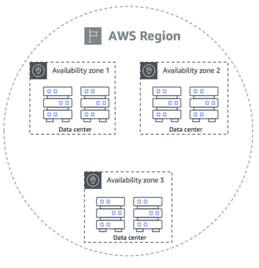
EC2 Architecture Overview
Regions and Availability Zones:
Regions: Geographically separate areas (e.g., US-East-1, AP-South-1).
Availability Zones (AZs): Isolated data centers within regions for fault tolerance.
2. Virtual Machines (Instances): EC2 provides virtualized servers.
3. Elastic Block Store (EBS): Persistent storage for EC2 instances.

Slide 58
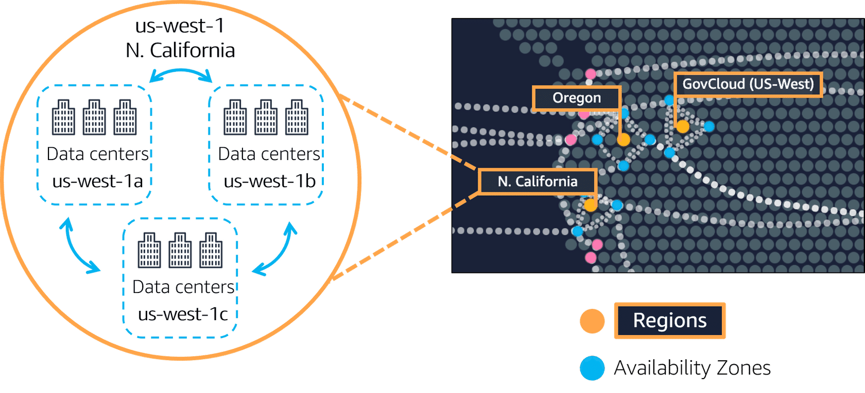
Regions vs Availability Zone vs Data Center

Slide 59
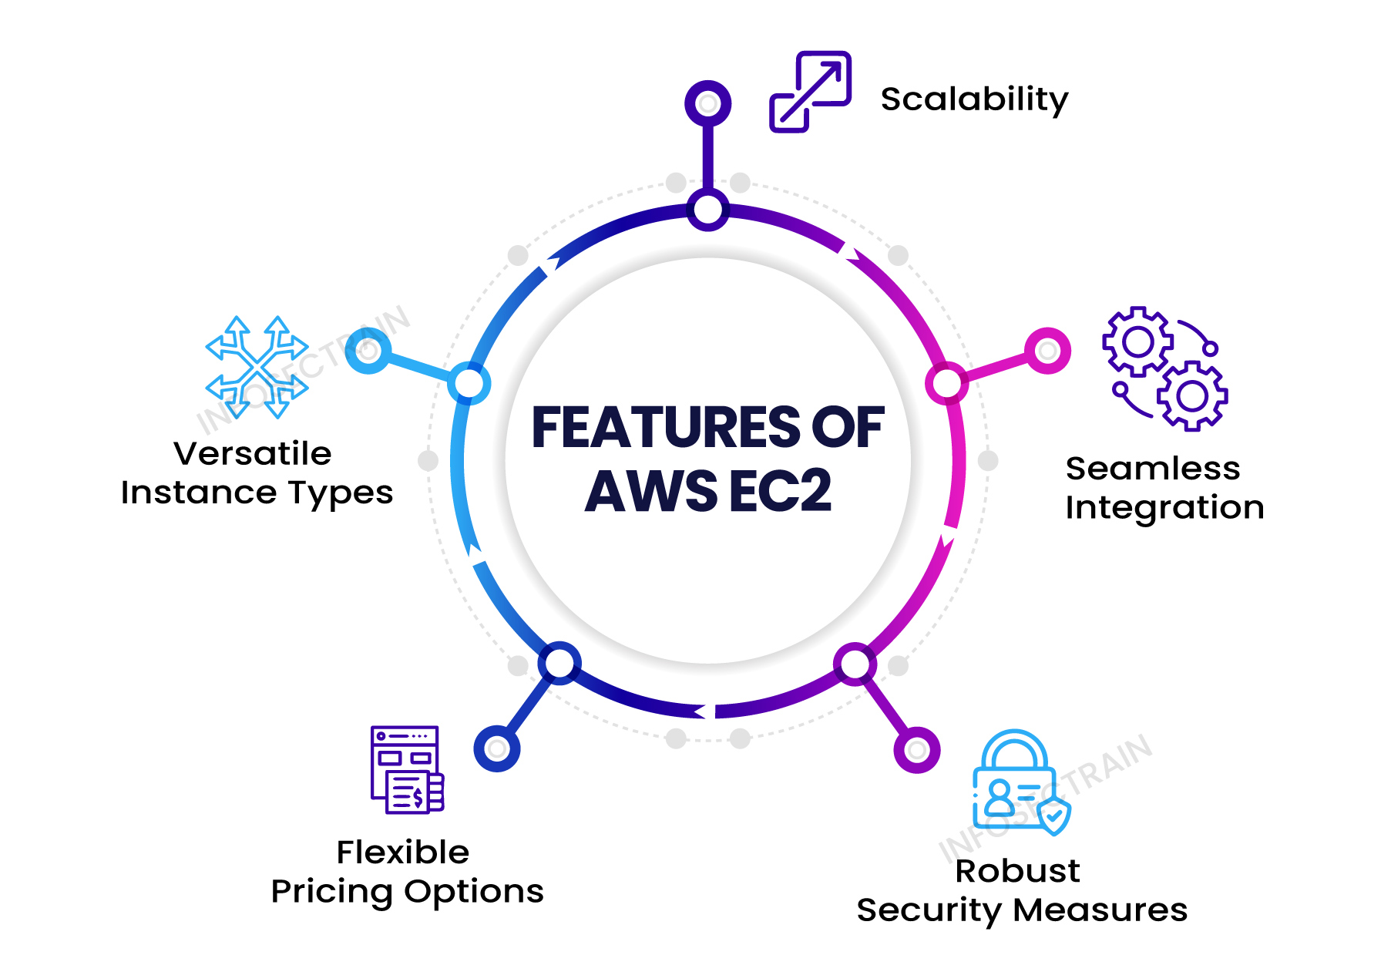
Key Features of Amazon EC2
Elasticity: Scale instances up/down based on workload.
Customizable Configurations: Wide selection of OS, instance types, and storage options.
Cost Management: Multiple pricing models to optimize expenses.
Networking: Secure, isolated environments via Virtual Private Cloud (VPC).
Integration: Works seamlessly with AWS services like S3, RDS, Lambda.

Slide 60
EC2 Instance Types
General Purpose: Balanced performance (e.g., t2.micro).
Compute Optimized: For compute-intensive workloads (e.g., c5.large).
Memory Optimized: For memory-intensive applications (e.g., r5.large).
Storage Optimized: For high-performance storage needs (e.g., i3.large).
Accelerated Computing: For GPU-based workloads (e.g., p3.large).

Slide 61
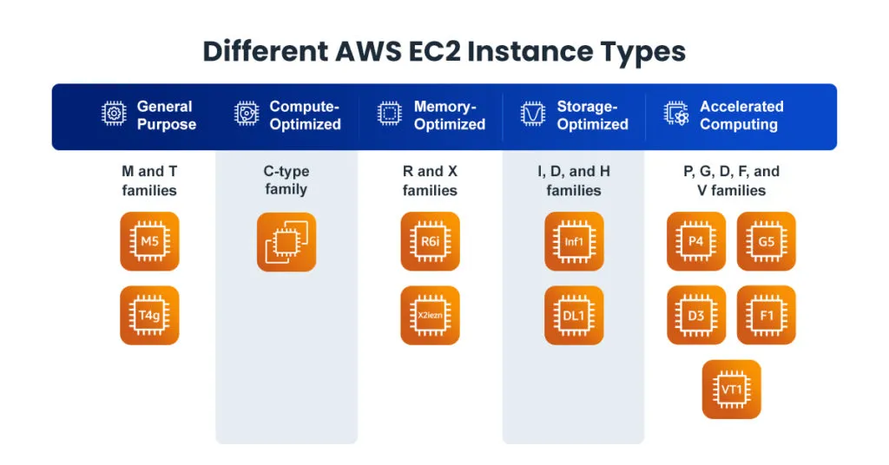

Slide 62
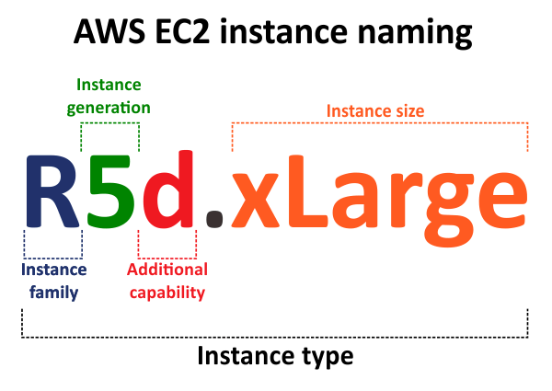

Slide 63
Use Cases of EC2
Web Hosting: Host websites and applications.
Big Data Analytics: Analyze large datasets efficiently.
Machine Learning: Train and deploy ML models.
Gaming: Power online multiplayer games.
DevOps: Test and deploy code in scalable environments.

Slide 64
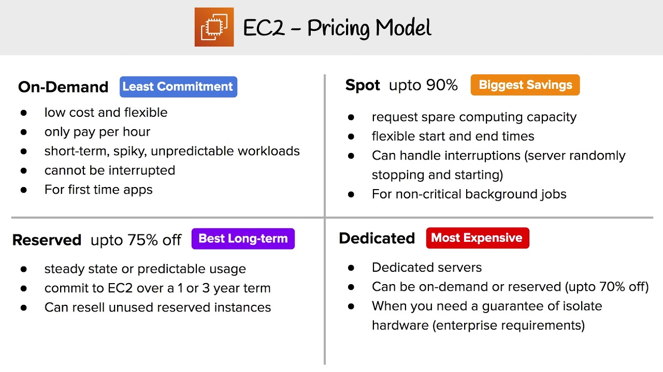
EC2 Pricing Models
On-Demand Instances: Pay for compute capacity per hour or second.
Reserved Instances: Commit for 1-3 years for up to 75% savings.
Spot Instances: Use unused EC2 capacity at steep discounts.
Savings Plans: Flexible pricing plan for long-term savings.
Dedicated Hosts: Dedicated physical servers for compliance requirements.

Slide 65
Security Features of EC2
IAM Integration: Fine-grained access control.
Security Groups: Virtual firewalls to control instance traffic.
Key Pairs: Encrypt connections via SSH.
VPC: Isolated networking environment.
Data Encryption: Encrypt data at rest (EBS, S3) and in transit (TLS).

Slide 66
Storage Options for EC2
Elastic Block Store (EBS): Persistent storage for single instances.
Instance Store: Temporary storage that persists only during instance lifecycle.
Elastic File System (EFS): Scalable file storage for multiple instances.
S3 Integration: Object storage for backups and archives.

Slide 67
EC2 Auto Scaling
Purpose: Automatically adjust compute resources to meet demand.
Benefits:
Reduces costs by scaling down during low demand.
Ensures high availability during traffic spikes.
Components:
Scaling Groups: Define instance pools.
Scaling Policies: Rules for scaling up/down.

Slide 68
Amazon EC2 and Networking
Elastic IP Addresses: Static IP addresses for EC2 instances.
Load Balancers:
Application Load Balancer (ALB): For HTTP/HTTPS traffic.
Network Load Balancer (NLB): For TCP traffic.
VPC Peering: Connect multiple VPCs for seamless communication.

Slide 69
Getting Started with EC2
Log in to the AWS Management Console.
Launch an instance:
Choose AMI (e.g., Ubuntu, Windows Server).
Select instance type (e.g., t2.micro).
Configure storage and networking.
Connect to the instance using SSH or RDP.

Slide 70
Advantages of EC2
Flexibility to choose from various configurations.
Global scalability with low latency.
Integration with other AWS services (e.g., S3, RDS).
Cost-effectiveness with multiple pricing models.

Slide 71
Summary
Amazon EC2 provides scalable, flexible, and cost-effective compute power.
Suitable for diverse use cases, from startups to large enterprises.
Key to leveraging cloud computing benefits in modern applications.

Slide 72
Amazon S3
The Backbone of Scalable Cloud Storage

Slide 73
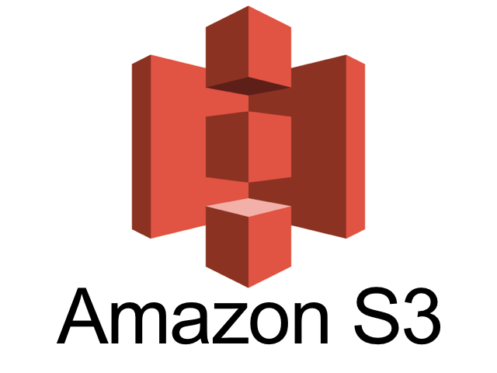
What is Amazon S3?
Amazon Simple Storage Service (S3): A scalable object storage service by AWS.
Purpose: Store and retrieve any amount of data from anywhere.
Use Cases:
Backup and restore
Data archiving
Big data analytics
Hosting static websites

Slide 74
Core Concepts
Bucket:
A container for storing objects.
Each bucket has a unique name within the AWS ecosystem.
Supports versioning, encryption, and access controls.
Object:
Files stored in buckets, accompanied by metadata.
Each object is identified by a unique key.
Key:
A string used to identify an object within a bucket.

Slide 75
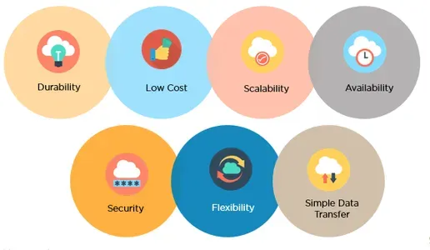
Key Features of Amazon S3
Scalability: Automatically scales storage capacity.
Durability: 99.999999999% (11 9's) durability.
Availability: High uptime and regional redundancy.
Security: Encryption and fine-grained access control.
Performance: Low-latency and high-throughput storage.

Slide 76
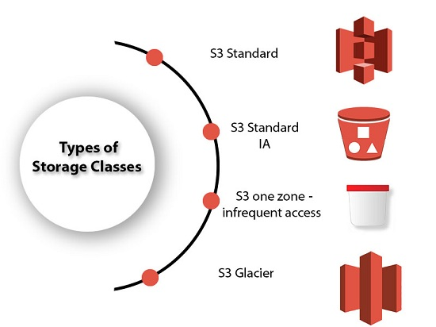
S3 Storage Classes
Standard: High durability, availability, and performance for frequently accessed data.
Standard-IA (Infrequent Access): Cheaper storage for less frequently accessed data.
One Zone-IA: Cost-effective for infrequently accessed data stored in a single Availability Zone.
Glacier: Low-cost storage for long-term archival.
Intelligent-Tiering: Automatically moves data between cost-effective tiers.

Slide 77
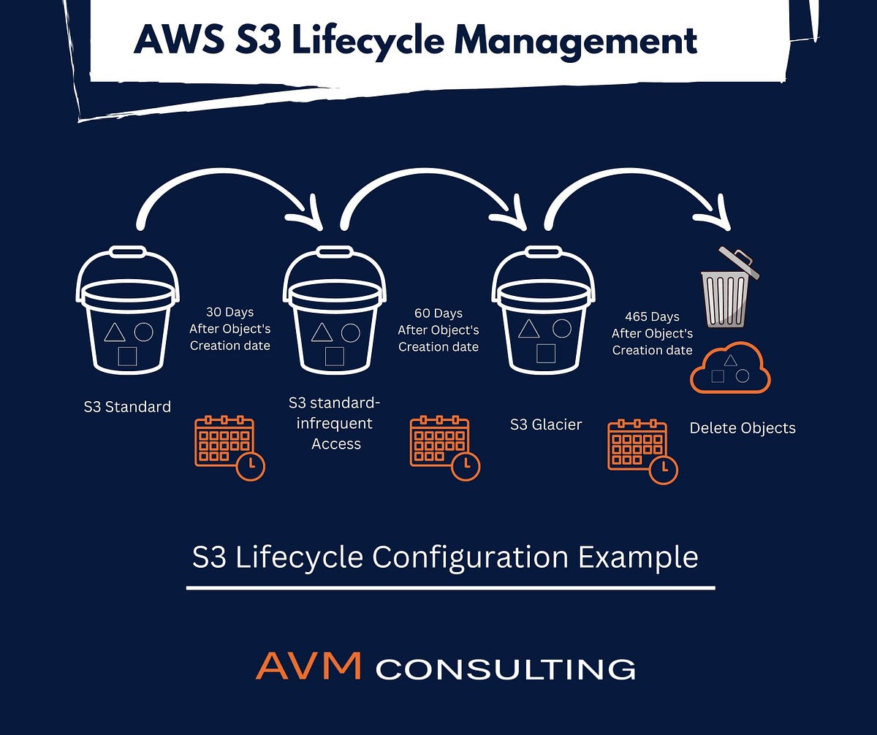

Slide 78
How Amazon S3 Works
Create a Bucket:
Use the AWS Console, CLI, or SDK to create a bucket.
Name it uniquely within the AWS global namespace.
Upload Objects:
Files are stored in the bucket as objects with metadata.
Access Objects:
Retrieve files using REST API, SDKs, or pre-signed URLs.

Slide 79
Benefits of Amazon S3
Reliability: Built on AWS global infrastructure.
Cost-Effectiveness: Pay only for storage used; no upfront costs.
Flexibility: Supports a wide range of use cases, from backups to web hosting.
Ease of Use: Easy to manage and configure with AWS tools.

Slide 80
Security Features
Data Encryption:
Server-Side Encryption (SSE): Encrypts data at rest.
Client-Side Encryption: Data encrypted before uploading.
Access Management:
IAM Policies: Control who can access what.
Bucket Policies: Define access rules for buckets.
S3 Access Points: Simplify managing access to shared buckets.
Compliance:
Meets regulatory standards like GDPR, HIPAA, and PCI DSS.

Slide 81
Real-World Use Cases
Data Backup and Archival:
Reliable storage for disaster recovery.
Static Website Hosting:
Cost-effective for hosting HTML, CSS, and JavaScript files.
Big Data Analytics:
Stores large datasets for tools like AWS Athena or Amazon EMR.
Media Storage:
Host and distribute video, images, and other media files globally.

Slide 82
Cost and Pricing Model
Storage Cost: Based on GB/month.
Data Transfer: Outbound transfer incurs costs, inbound is free.
Request Pricing:
Costs for GET, PUT, DELETE operations.
Glacier Retrieval Costs: Vary by retrieval speed (Instant, Expedited, Standard).

Slide 83
S3 Best Practices
Enable Versioning: Protect against accidental deletion.
Use Lifecycle Policies: Optimize storage costs.
Secure Your Data: Enforce encryption and IAM best practices.
Monitor Usage: Use CloudWatch for monitoring and cost tracking.

Slide 84
Summary
Amazon S3 is a foundational service for AWS cloud computing.
Key Takeaways: Scalable, durable, secure, and cost-effective storage.
Encouragement: Explore S3 by creating a free-tier AWS account.

Slide 85
AWS IAM (Identity and Access Management)
Securing AWS Resources with Roles, Policies, and Permissions

Slide 86
Objectives
Understand the purpose of IAM in AWS
Learn key IAM components: Users, Groups, Roles, and Policies
Explore IAM security best practices
Hands-on: Creating and managing IAM entities

Slide 87
What is IAM?
Definition: IAM allows secure management of access to AWS services and resources
Key Features:
Manage users and their access
Granular permissions
Identity federation for external access
Free service (pay only for used AWS resources)

Slide 88
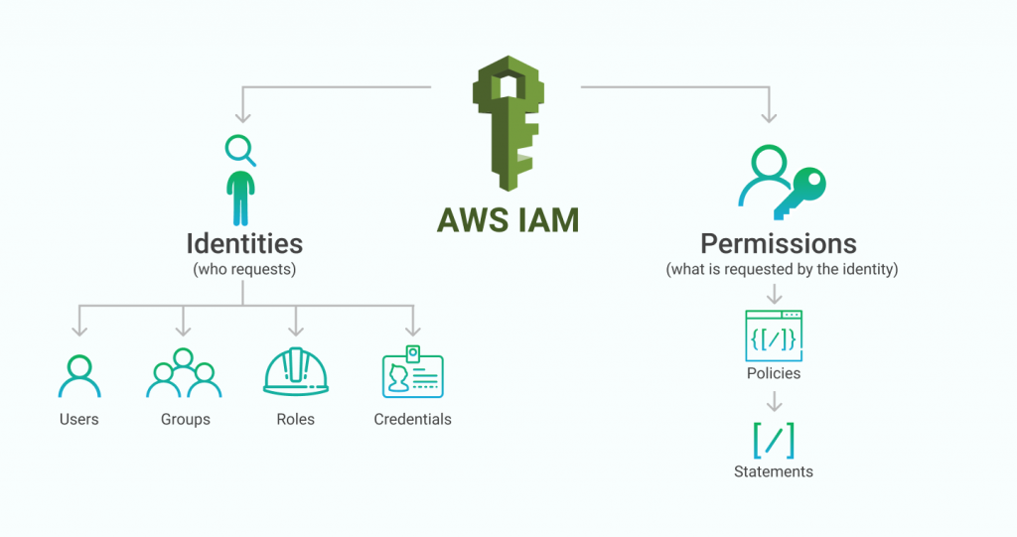
Key IAM Concepts
Users: Individual identities with credentials to access AWS
Groups: Collections of users sharing the same permissions
Roles: Temporary access to AWS resources, used by applications or services
Policies: JSON documents defining permissions

Slide 89
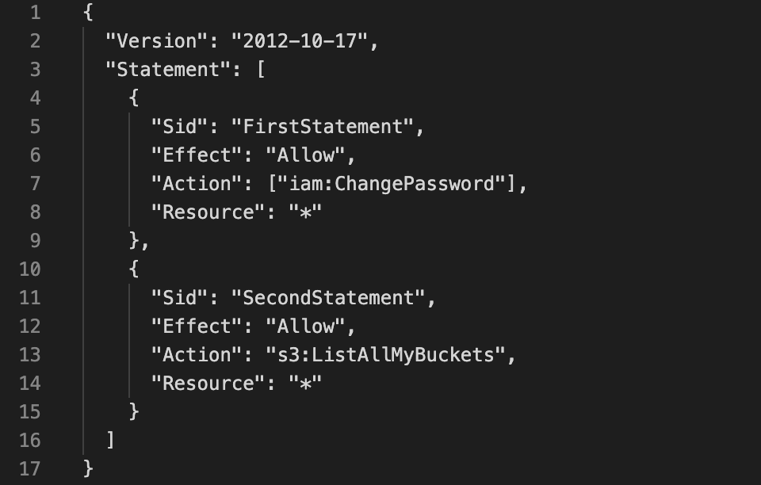
IAM Policies Explained
Types of Policies:
AWS Managed Policies (predefined)
Customer Managed Policies (customizable)
Inline Policies (attached directly to an entity)
Structure:
Actions: What can be done (e.g., s3:ListBucket)
Resources: Where the action is applied (e.g., arn:aws:s3:::bucket-name)
Effect: Allow or Deny

Slide 90
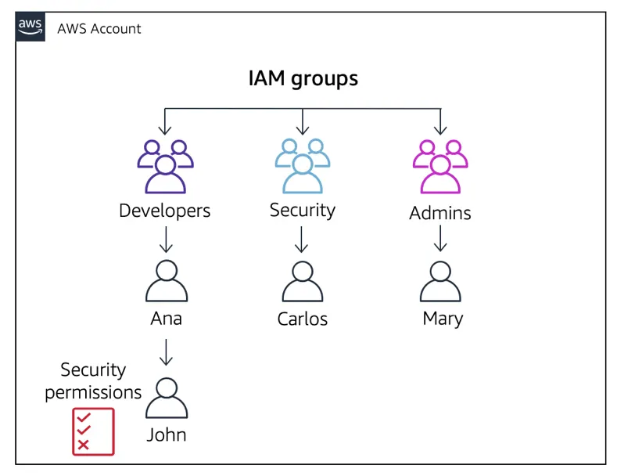
IAM Components Relationship
Diagram showing how users, groups, roles, and policies interact:
Users belong to groups
Groups have attached policies
Roles are assumed by users or AWS services

Slide 91
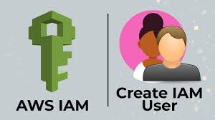
Hands-On: Creating an IAM User
Objective: Create a user with specific permissions
Steps:
Go to the IAM Dashboard
Click "Add User"
Assign access type (console or programmatic)
Attach a policy (e.g., AmazonS3ReadOnlyAccess)
Download the access credentials

Slide 92
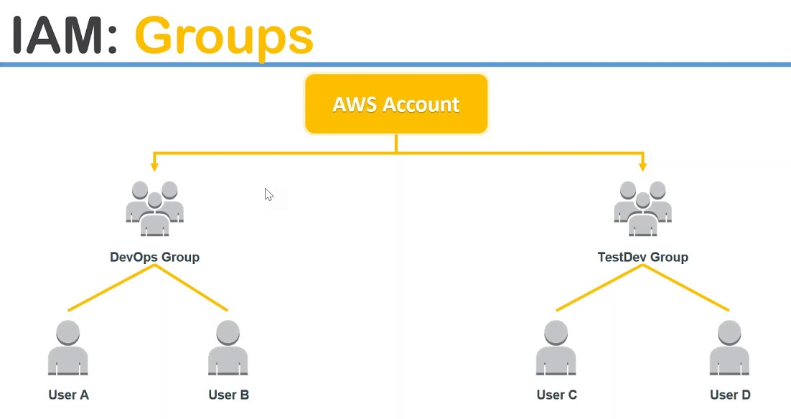
Hands-On: Creating a Group
Objective: Create a group with shared permissions
Steps:
Create a group in IAM
Attach a policy (e.g., AmazonEC2FullAccess)
Add users to the group

Slide 93
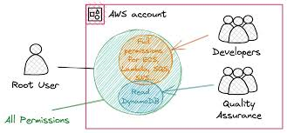
Hands-On: Creating a Role
Objective: Grant temporary access to a service (e.g., EC2 accessing S3)
Steps:
Create a role in IAM
Select a use case (e.g., AWS Service > EC2)
Attach a policy (e.g., AmazonS3FullAccess)
Assign the role to an EC2 instance

Slide 94
IAM Security Best Practices
Enable Multi-Factor Authentication (MFA)
Follow the principle of least privilege
Rotate access keys regularly
Use IAM roles instead of sharing credentials
Monitor activity with CloudTrail

Slide 95
Real-World Use Cases
Developers: Programmatic access to deploy applications
Administrators: Manage accounts, services, and users
Applications: Access S3, DynamoDB, or other resources using roles

Slide 96
Summary
IAM is essential for securing AWS resources
Key components: Users, Groups, Roles, and Policies
Always implement security best practices

Slide 97
AWS VPC (Virtual Private Cloud)
Building Secure and Scalable Cloud Networks

Slide 98
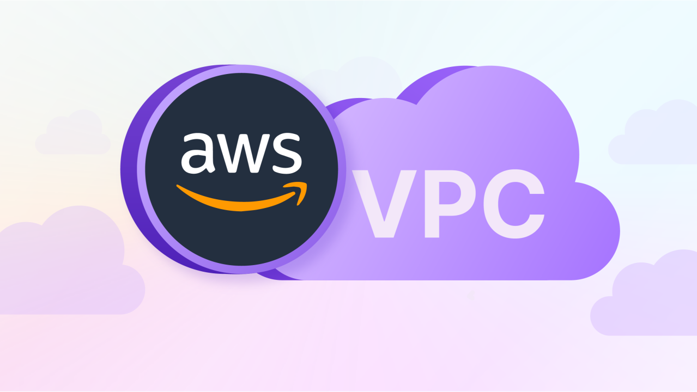
What is Amazon VPC?
Amazon Virtual Private Cloud (VPC) is a logically isolated section of the AWS Cloud where you can define your virtual network.
Purpose:
Launch AWS resources in a secure and controlled environment.
Customize networking to meet specific requirements.
Use Cases:
Hosting web applications securely.
Extending on-premises data centers to the cloud.
Creating multi-tier architectures.

Slide 99

Key Benefits of Amazon VPC
Isolation: Fully isolate resources for enhanced security.
Flexibility: Customize IP addressing, subnets, and routing.
Security: Leverage security groups and network ACLs.
Scalability: Expand resources as needed without manual reconfiguration.

Slide 100
Core Components of a VPC
Subnets: Public and private sub-networks within a VPC.
Route Tables: Rules for directing traffic within the network.
Internet Gateway (IGW): Access the internet from your VPC.
NAT Gateway: Allow private instances to initiate internet connections.
Elastic IP (EIP): Static public IP for resources.

Slide 101
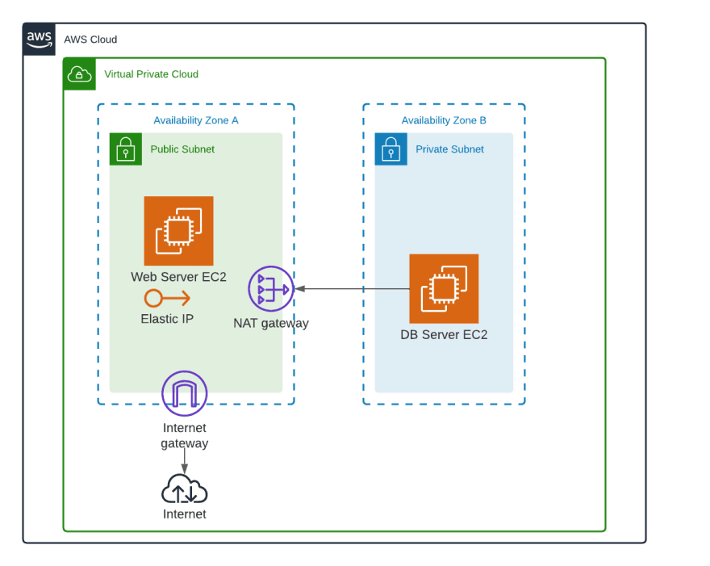
Public and Private Subnets
Public Subnet:
Direct internet access via the Internet Gateway (IGW).
Ideal for web servers and other public-facing resources.
Private Subnet:
No direct internet access.
Used for sensitive resources like databases and backend systems.

Slide 102
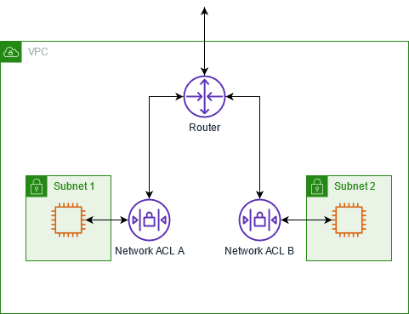
Security Features in VPC
Security Groups:
Instance-level firewall.
Controls inbound/outbound traffic.
Network ACLs (Access Control Lists):
Subnet-level firewall.
Allows/denies traffic at the subnet level.

Slide 103
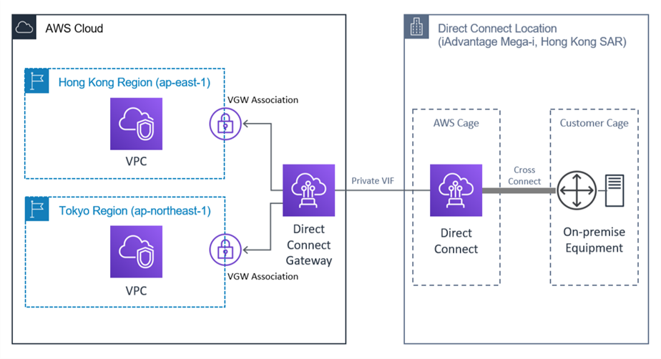
Connecting to VPC
Internet Gateway (IGW): Enables internet access for public subnets.
VPN and Direct Connect: Securely connect your on-premises network to AWS.
Peering Connections: Connect multiple VPCs for resource sharing.

Slide 104
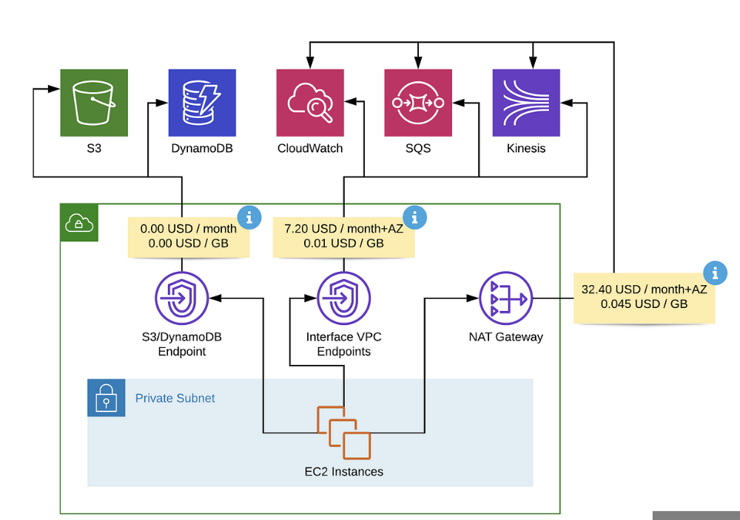
Advanced Networking in VPC
NAT Gateway: Allow instances in private subnets to access the internet without exposing them.
Elastic Load Balancer (ELB): Distribute traffic across instances in public and private subnets.
VPC Endpoints: Privately connect VPC to AWS services without using IGW or NAT.

Slide 105
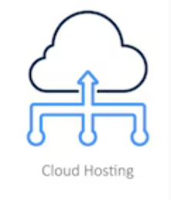
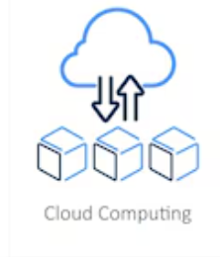

VPC Use Cases
Web Hosting: Deploy scalable, secure web applications.
Hybrid Cloud: Extend on-premises networks using VPN or Direct Connect.
Data Analytics: Run secure data analysis workflows.

Slide 106
VPC Best Practices
Design subnets for specific use cases (public, private, isolated).
Use least privilege principles with security groups and ACLs.
Monitor traffic using VPC Flow Logs.
Leverage NAT Gateways for secure internet access from private subnets.

Slide 107
Summery
VPC provides isolated, secure, and customizable networking in AWS.
Plan and design the VPC architecture based on application needs.
Utilize security and monitoring tools to safeguard resources.

Slide 108
Introduction to Linux
Exploring the Foundation of Open Source Operating Systems

Slide 109
What is Linux?
Linux is an open-source and Unix*-like operating system.
Created by Linus Torvalds in 1991.
Used in diverse fields: Servers, desktops, embedded systems, and more.
Key Point: Linux powers over 90% of servers on the internet. *UNIX is a multi-user, multitasking operating system (OS) that was developed in the late 1960s by Bell Laboratories at AT&T

Slide 110
Brief History of Linux
Unix (1969): Inspiration for Linux.
GNU Project (1983): Free software foundation started by Richard Stallman.
1991: Linus Torvalds announced Linux Kernel.
Open Source Revolution: Collaboration among developers worldwide.

Slide 111
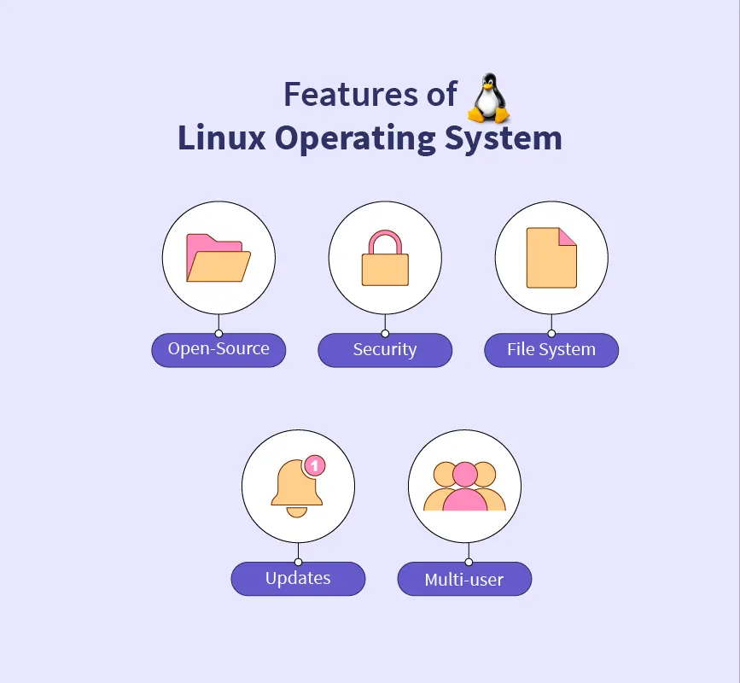
Core Features of Linux
Open Source: Freely available and customizable.
Multiuser Support: Many users can work simultaneously.
Portability: Runs on a wide range of hardware.
Security: Built-in user and process isolation.
Stability: Reliable for long-term use.

Slide 112
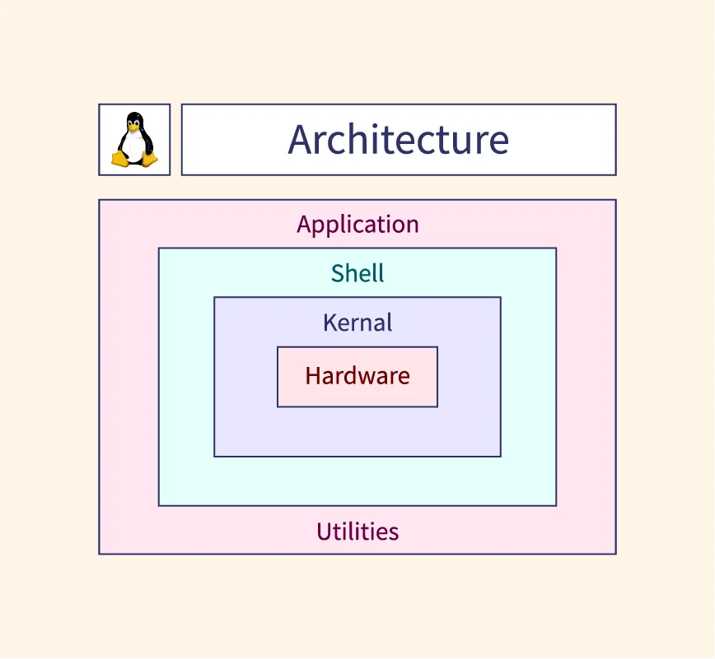
Linux Architecture
Hardware: Physical components of the computer.
Kernel: The core that interacts with hardware.
System Libraries: Provide essential functionality.
Shell: Command-line interface for user interaction.
Applications: Software running on top of the OS.

Slide 113
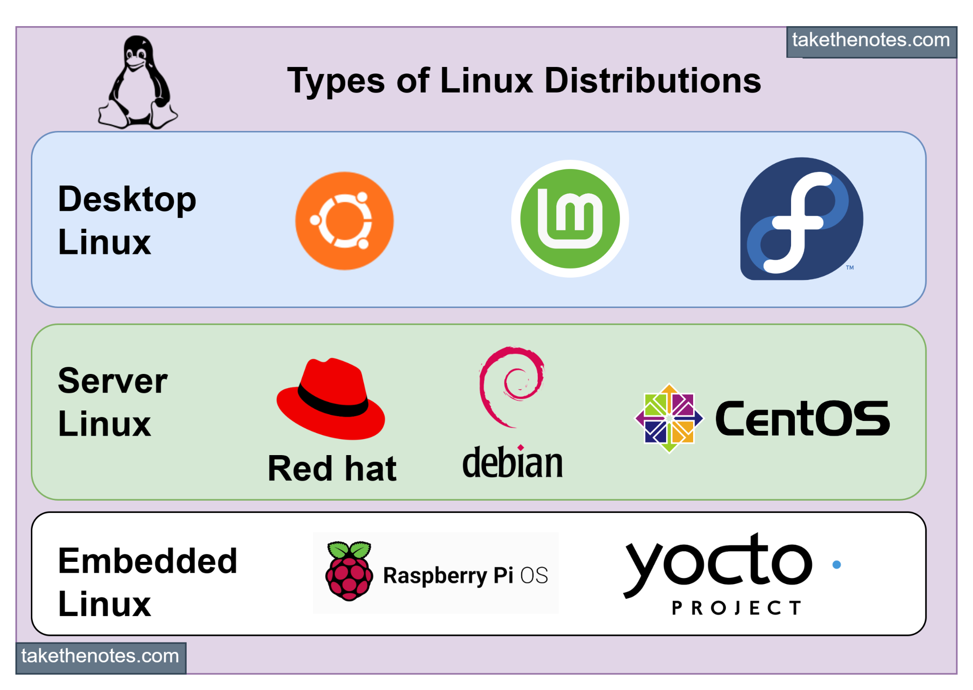
Linux Distributions
What is a Distribution?
A collection of the Linux kernel, software packages, and tools.
Popular Distributions:
Ubuntu: User-friendly.
Fedora: Cutting-edge software.
Debian: Stability and reliability.
Arch Linux: Customizable and minimalistic.
Specialized lightweight distros:
Tiny Core Linux (~16 MB)
Puppy Linux (~300 MB)

Slide 114
Why Choose Lightweight Linux Distros?
Designed for systems with low RAM and storage.
Suitable for:
Old computers
Embedded systems
Minimalistic environments
Examples:
Tiny Core Linux: ~16 MB
Damn Small Linux: ~50 MB
AntiX: ~400 MB
Bodhi Linux: ~700 MB

Slide 115
Basic Linux Commands
Navigating the File System:
ls: List files.
cd: Change directory.
pwd: Print working directory.
File Management:
mkdir: Create a directory.
rm: Remove a file or directory.
cp: Copy files.
System Monitoring:
top: View running processes.
df -h: Check disk usage.
free -m: Check memory usage.

Slide 116
Real-World Applications of Linux
Web Servers: Powering Google, Facebook, and Twitter.
Supercomputers: Runs on 100% of the world’s top 500 supercomputers.
IoT Devices: Used in smart devices and embedded systems.
Programming: Preferred platform for developers due to robust tools.
Gaming: Platforms like SteamOS bring gaming to Linux.

Slide 117
Linux Desktop Environments
GNOME: Modern and simple.
KDE Plasma: Highly customizable.
XFCE: Lightweight and fast.
LXQt: Minimal resource usage.
Mate: Traditional desktop feel.

Slide 118
Myths and Misconceptions
"Linux is hard to use" → Modern distros are beginner-friendly.
"No software is available" → Vast libraries of applications.
"Only experts use Linux" → Distros like Ubuntu and Linux Mint are for everyone.

Slide 119
Advantages of Linux
Cost: Free to use.
Customizability: Tailor it to your needs.
Performance: Runs efficiently on all hardware.
Security: Resilient against malware and viruses.
Community: Active global support.

Slide 120
Challenges of Linux
Learning curve for beginners.
Software compatibility: Some proprietary software may not run.
Hardware drivers: Rare cases of unsupported hardware.

Slide 121
Conclusion
Linux is a versatile, secure, and open-source OS.
Powers much of today’s technology and infrastructure.
Encouragement: Start small, experiment with a lightweight distro.
“The Linux community is always there to support you.”

Slide 122
AWS Auto Scaling and
Load Balancing
Optimizing Scalability and Availability in the Cloud

Slide 123
Agenda
Auto Scaling
Load Balancing
Key Features and Benefits
How They Work Together
Use Cases
Real-World Examples
Demo (Optional)
Summary

Slide 124
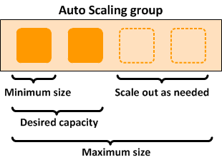
Auto Scaling
Automatically adjusts the number of compute resources to meet demand.
Key Benefits:
Ensures application availability.
Reduces costs by scaling down during low traffic.
Improves performance during traffic spikes.

Slide 125
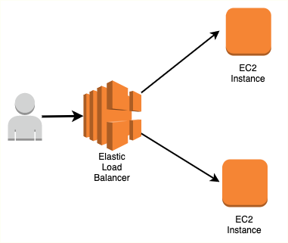
Load Balancing
Distributes incoming traffic across multiple resources to prevent overloading any single resource.
Types of Load Balancers in AWS:
Application Load Balancer (ALB): Layer 7 (HTTP/HTTPS) routing.
Network Load Balancer (NLB): Layer 4 (TCP/UDP) routing.
Classic Load Balancer: Legacy support for Layer 4 and 7.

Slide 126
Key Features and Benefits
Auto Scaling Features:
Dynamic Scaling: Automatically adjusts resources based on traffic.
Predictive Scaling: Uses machine learning to predict demand patterns.
Scheduled Scaling: Pre-defined scaling based on known traffic times.
Load Balancing Features:
Health Checks: Ensures traffic is sent only to healthy instances.
Sticky Sessions: Keeps user sessions connected to the same instance.
SSL Termination: Manages SSL decryption to offload instance workload.
Cross-Zone Load Balancing: Distributes traffic evenly across zones.

Slide 127
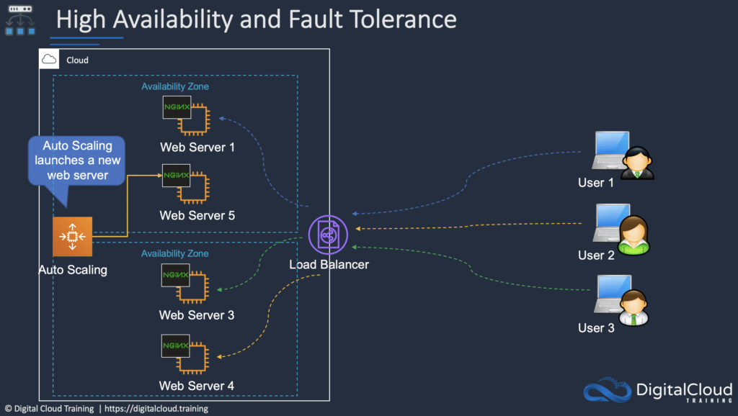
How They Work Together
Scenario: High traffic to a web application.
Load Balancer distributes traffic to multiple instances.
Auto Scaling adds more instances as traffic increases.
When traffic decreases, Auto Scaling reduces instances to save costs.
Outcome: Improved performance, reduced costs, and no downtime.

Slide 128
Use Case
E-commerce Platforms: Handle seasonal traffic spikes during sales events.
Media Streaming: Maintain smooth streaming by scaling resources based on viewer demand.
Web Applications: Ensure high availability and seamless user experiences.

Slide 129
Real-World Example
Case Study:
A streaming service like Netflix uses Auto Scaling to dynamically allocate resources during new show launches.
Load Balancers ensure traffic is evenly distributed among servers to prevent crashes.
Metrics:
99.99% uptime.
Significant cost savings during off-peak hours.

Slide 130
Demo Step
Step 1: Create an Auto Scaling group in the AWS Management Console.
Step 2: Attach an Application Load Balancer.
Step 3: Configure scaling policies and health checks.
Step 4: Monitor scaling activities in CloudWatch.

Slide 131
Summary
Auto Scaling ensures cost-efficient scalability by adjusting resources dynamically.
Load Balancing enhances application availability and distributes traffic efficiently.
Together, they form the backbone of resilient cloud architectures.

Slide 132
Amazon SQS & SNS
Reliable Messaging and Notifications for Modern Applications

Slide 133
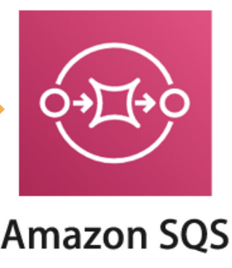
Amazon SQS (Simple Queue Service)
What is Amazon SQS?
Fully managed message queuing service.
Decouples* and scales microservices and serverless applications.
Why Use SQS?
Reliable, scalable, and cost-effective message delivery.
Handles large workloads and asynchronous communication.
*Services don’t need to directly talk to each other. One sends a message to the queue, and the other picks it up when ready

Slide 134
Key Features of SQS
Fully managed and serverless.
Two queue types: Standard (high throughput) and FIFO (strict order).
Secure with AWS KMS encryption.
Supports message retention from 1 minute to 14 days.

Slide 135
Types of Queues
Standard Queue:
High throughput.
At-least-once delivery (potential duplication).
Best-effort ordering (not strict).
FIFO Queue:
Limited throughput.
Exactly-once delivery.
Strict message order.

Slide 136
How SQS Works
Message Producers send messages to the queue.
Messages are temporarily stored in the SQS Queue.
Message Consumers poll and process the messages.
Processed messages are deleted explicitly.

Slide 137
SQS Use Cases
Decoupling microservices.
Asynchronous task execution.
Buffering for burst traffic.
Background jobs.

Slide 138
Security and Monitoring
IAM Policies: Control access to SQS.
Encryption: Server-side with AWS KMS.
Monitoring: Amazon CloudWatch for metrics like message count and age.

Slide 139
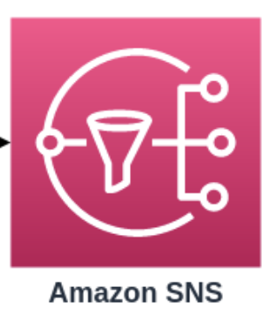
Amazon SNS (Simple Notification Service)
What is Amazon SNS?
Fully managed publish/subscribe messaging service.
Enables event-driven and real-time communication.
Why Use SNS?
High fan-out for messages.
Supports multiple protocols (HTTP, Lambda, SMS, etc.).

Slide 140
Key Features of SNS
Topic-based publish/subscribe model.
Message delivery to multiple subscribers.
Integration with SQS, Lambda, and email/SMS.
Message filtering and attributes.

Slide 141
How SNS Works
Publishers send messages to a topic.
SNS distributes the message to subscribers.
Supports multiple delivery protocols (HTTP, SQS, Lambda, SMS, etc.).

Slide 142
SNS Use Cases
Real-time event notifications.
Application alerts (e.g., system failures).
Distributing updates to multiple systems.

Slide 143
Security and Monitoring
IAM Policies: Restrict who can publish/subscribe to topics.
Encryption: Data at rest and in transit.
Monitoring: CloudWatch metrics for delivery success and failures.

Slide 144
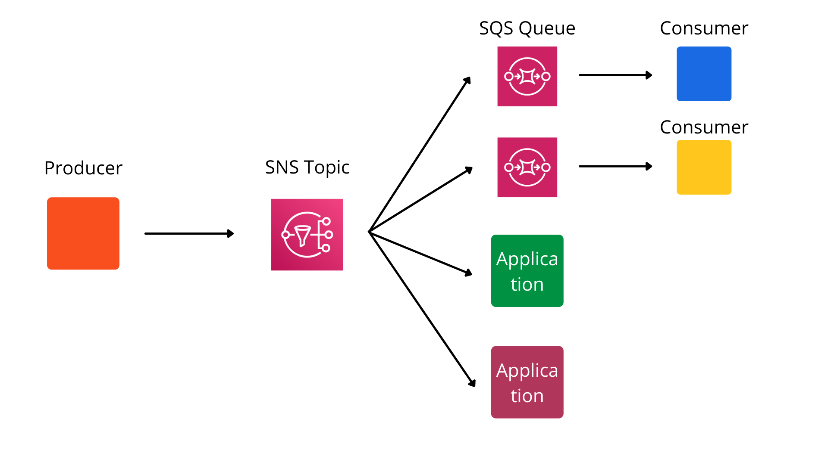
Using SQS and SNS Together
SNS can fan-out messages to multiple SQS queues.
Benefits:
Decouple publishers from consumers.
Reliable delivery with SQS buffering.

Slide 145
Practical Example
Scenario:
SNS topic publishes system updates.
Multiple SQS queues process updates for different microservices.
Advantages of Integration:
Scalable and fault-tolerant architecture.
Combines the strengths of both services (real-time and reliable messaging).

Slide 146
Summary
Amazon SQS: Reliable queuing for asynchronous messaging.
Amazon SNS: Real-time notifications with publish/subscribe.
Integration allows decoupling and scaling distributed systems.

Slide 147
AWS Route 53 (DNS)
Enhancing Domain Management and Global Traffic Optimization

Slide 148
Agenda
Introduction to Route 53
Key Features and Benefits
Routing Policies
Hosted Zones and Record Types
Integration with AWS Services
Use Cases
Real-World Examples
Demo (Optional)
Summary

Slide 149

Amazon Route 53
A highly available and scalable Domain Name System (DNS) web service from AWS.
Primary Functions:
Domain registration.
DNS routing.
Health checks and traffic management.
Why Route 53?
Global availability.
Seamless integration with AWS services.
Highly reliable and secure.

Slide 150
Key Features and Benefits
Features:
Domain Registration: Register and manage domain names directly from AWS.
DNS Management: Create and manage DNS records for domains.
Health Checks: Monitor the health of resources and reroute traffic if needed.
Traffic Flow: Optimize traffic globally with routing policies.
Integration: Works seamlessly with other AWS services.
Benefits:
High Availability: Built-in redundancy for reliable DNS service.
Scalability: Supports traffic for large-scale applications.
Security: DNSSEC support for secure DNS management.

Slide 151
Routing Policies
Simple Routing: Basic DNS resolution for a single resource.
Weighted Routing: Distribute traffic based on assigned weights.
Latency Routing: Directs traffic to the region with the lowest latency.
Geolocation Routing: Routes traffic based on user location.
Failover Routing: Ensures high availability by redirecting traffic to a backup resource.
Multi-Value Answer: Returns multiple IP addresses for redundancy.

Slide 152
Hosted Zones and Record Types
Hosted Zones:
Public Hosted Zone: Manages DNS records for domains accessible on the internet.
Private Hosted Zone: Manages DNS records for internal AWS resources.
Record Types:
A (Address Record): Maps domain to an IPv4 address.
AAAA: Maps domain to an IPv6 address.
CNAME: Alias for another domain name.
MX: Mail exchange server.
TXT: Holds text information for verification or other purposes.

Slide 153
Integration with AWS Services
Works seamlessly with services like:
Elastic Load Balancer (ELB) for distributing traffic.
CloudFront for content delivery.
S3 for static website hosting.
Enables advanced configurations:
Automatically updates DNS records for Auto Scaling groups.
Secure domain connections with ACM (provides SSL).

Slide 154
Use Cases
E-commerce Platforms:
Efficiently handle global traffic with geolocation routing.
Global Applications:
Ensure low-latency access using latency-based routing.
Disaster Recovery:
Maintain availability using failover routing.

Slide 155
Real-World Example
A global SaaS provider uses Route 53 for:
Managing domains across regions.
Ensuring high availability with failover routing.
Optimizing user experience with latency-based routing.
Metrics:
Improved global accessibility.
99.99% uptime for critical applications.

Slide 156
Demo
Step 1: Create a hosted zone in the AWS Management Console.
Step 2: Add DNS records (A, CNAME, etc.).
Step 3: Configure routing policies.
Step 4: Test DNS resolution using tools like nslookup.

Slide 157
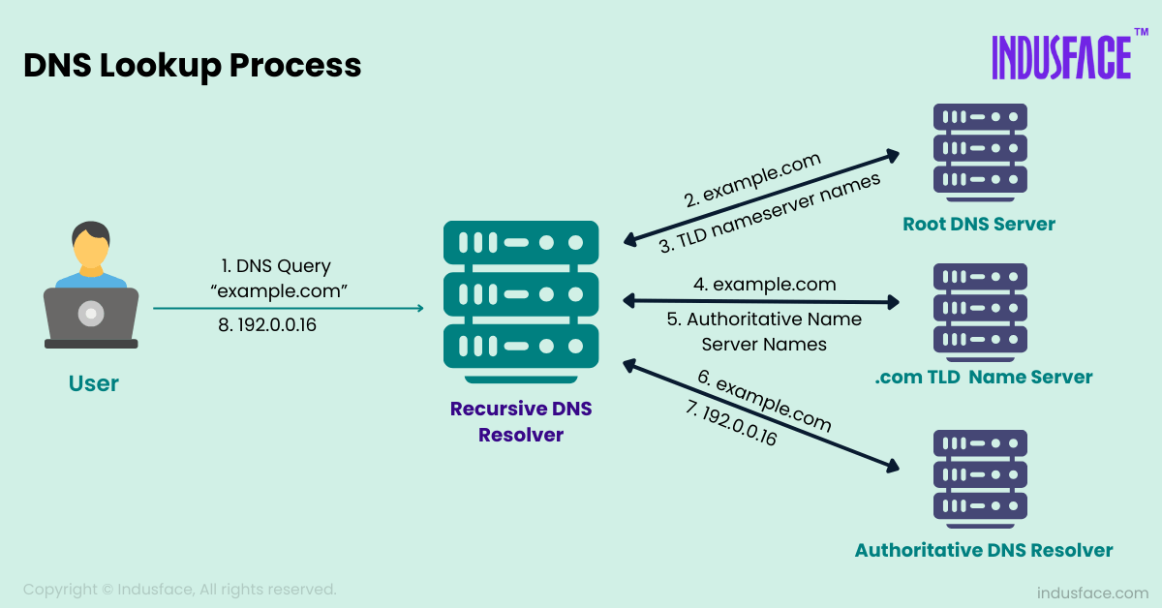

Slide 158
Summary
Route 53 offers a scalable and reliable DNS service.
Supports advanced traffic management with various routing policies.
Seamless integration with AWS services ensures global optimization.

Slide 159
AWS SES (Simple Email Service)
Email Sending Simplified with AWS

Slide 160


Slide 161

What is Amazon SES?
A cloud-based email sending service for sending transactional and marketing emails.
Features:
High deliverability
Scalable
Reliable
Use Cases:
Notifications
Marketing campaigns
Transactional emails (e.g., OTPs)

Slide 162

Key Features of Amazon SES
Highly scalable and cost-effective.
Support for bulk and transactional emails.
Built-in analytics (open, click-through, and bounce rates).
Integration with other AWS services like Lambda and SNS.

Slide 163
How Amazon SES Works
Basic flow: Verify domain/email → Create SMTP credentials → Send email.
Identity types: Domain vs. Email Address.
Authentication methods: SPF, DKIM, and DMARC.
DKIM ensures that an email has not been altered in transit and verifies the sender's authenticity by attaching a cryptographic signature.
SPF allows the domain owner to specify which mail servers are authorized to send emails on behalf of their domain.
DMARC (Domain-based Message Authentication, Reporting, and Conformance) is an email authentication protocol designed to protect your domain from spoofing and phishing attacks. It builds on SPF and DKIM to provide a policy framework for email authentication and reporting.

Slide 164

Sending Emails with AWS SES
Sending emails via SMTP Interface.
Using AWS SDKs (e.g., Boto3 for Python).
Limits and quotas.

Slide 165


Slide 166

SES Pricing
Emails sent: $0.10 per 1,000 emails
Attachments: Cost for data transfer applies
Free Tier: 62,000 emails per month when sent from an EC2 instance

Slide 167

SES Best Practices
Use DKIM and SPF for email authentication.
Monitor bounce and complaint rates.
Regularly review email metrics.
Using IAM for access control.

Slide 168
Question: Sending Bulk Emails to Customers
You have an e-commerce website and need to send order confirmation emails to thousands of customers every day. You’ve decided to use AWS SES for this purpose.
What steps would you take to configure SES to handle these bulk emails effectively?
How would you ensure that your emails are successfully delivered and avoid being marked as spam?
How would you monitor and handle bounce rates or complaints using AWS SES?

Slide 169
Steps to handle these bulk emails effectively
Setup Sender Identity
Request Production Access
Use IAM for Access Control
Manage Quotas and Limits
Configure Sending
Leverage SNS for Feedback
Monitor Performance

Slide 170

Thank You

Slide 171
Data Centers
Design, Architecture, and Tier Levels

Slide 172


Slide 173


Slide 174

Data Centers
Data Center: A data center is a facility used to house computer systems and associated components, such as telecommunications and storage systems.
Purpose:
Centralized management of IT resources
Support for critical applications
High availability and redundancy

Slide 175

Key Components:
Key Components:
Servers
Storage Systems
Networking Equipment
Cooling Systems
Power Supply Units
Security Systems
Interdependence: Efficient operation relies on seamless integration of these components.

Slide 176
Data Center Design Principles
Scalability: Design for future growth.
Redundancy: Minimize single points of failure.
Efficiency: Optimize power and cooling.
Security: Physical and virtual protection.
Sustainability: Eco-friendly solutions.

Slide 177
Data Center Architecture
Layers:
Physical Layer: Hardware and infrastructure
Virtual Layer: Virtualized servers and networks
Application Layer: Software and services
Topology:
Star
Mesh
Leaf-Spine

Slide 178
Power Efficiency in Data Centers
Key Metrics:
PUE (Power Usage Effectiveness): Ratio of total facility energy to IT equipment energy.
DCiE (Data Center Infrastructure Efficiency): Inverse of PUE.
Techniques to Improve Efficiency:
Energy-efficient hardware
Liquid cooling systems
Renewable energy sources

Slide 179

Tier Levels of Data Centers
Classification system based on uptime and redundancy.
Tiers:
Tier I: Basic Capacity (No redundancy)
Tier II: Redundant Capacity
Tier III: Concurrently Maintainable
Tier IV: Fault-Tolerant (Fully redundant systems)

Slide 180
Data Center Security
Aspects:
Physical Security: CCTV, access control
Cybersecurity: Firewalls, encryption
Disaster Recovery: Backup and replication
Importance: Protect data integrity and availability.

Slide 181
Sustainability in Data Centers
Challenges: High energy consumption.
Solutions:
Use of renewable energy.
Efficient cooling systems.
Green certifications (LEED, Energy Star).

Slide 182

Case Study: Efficient Data Center Design
Google’s Data Centers
Techniques: AI-based cooling, renewable energy use.
Outcome: Significant energy savings.

Slide 183
Summary
Data centers are critical for modern IT infrastructure.
Design and efficiency directly impact performance and sustainability.
Understanding tier levels helps in planning for required uptime and redundancy.

Slide 184
Previous Class Test Diagram

Slide 185

Auto Scaling

Slide 186

VPC

Slide 187
Virtualization: Future of Computing
A deep dive into the concepts, types, and applications of virtualization.

Slide 188

Introduction to Virtualization
Virtualization is the process of creating a virtual version of computing resources such as servers, storage devices, networks, or even operating systems.
Key Benefits:
Improved resource utilization.
Reduced IT costs.
Enhanced flexibility and scalability.

Slide 189


Slide 190
Types of Virtualization
1. Server Virtualization: Partitioning a physical server into multiple virtual servers.
2. Desktop Virtualization: Allows users to access desktops remotely.
3. Network Virtualization: Combines hardware and software network resources into a single, software-based entity.
4. Storage Virtualization: Pools physical storage resources into a single virtual resource.

Slide 191

What is Hypervisor?
A hypervisor, also known as a virtual machine monitor (VMM) or virtualizer, is a type of computer software, firmware or hardware that creates and runs virtual machines.

Slide 192


Slide 193
How Virtualization Works
Core Components:
Hypervisor: Software that creates and manages virtual machines (VMs).
Guest OS: The operating system running inside the VM.
Host OS: The operating system managing the physical hardware.
Types of Hypervisors:
Type 1: Runs directly on hardware (e.g., VMware ESXi).
Type 2: Runs on a host operating system (e.g., VirtualBox).

Slide 194

Advantages of Virtualization
Data Center Consolidation initiative
Cost Savings:
Lower hardware requirements.
Reduced energy consumption.
Flexibility:
Easy migration of workloads.
Scalability.
Improved Disaster Recovery:
Backups and snapshots.

Slide 195
Challenges of Virtualization
Initial Costs: Higher upfront costs for setup.
Complexity: Requires expertise for configuration and maintenance.
Performance Overhead: Potential decrease in performance due to resource sharing.
Security Concerns: Risks like VM escape and hypervisor attacks.

Slide 196
Applications of Virtualization
Cloud Computing: Foundation for services like IaaS, PaaS, and SaaS.
Development and Testing: Isolated environments for software development.
Disaster Recovery: Quick restoration of systems.
Education and Training: Virtual labs and simulations.

Slide 197
Future of Virtualization
Emerging Trends:
Containerization (e.g., Docker, Kubernetes).
Edge Computing.
Virtual Reality (VR) and Augmented Reality (AR).
Impact: Greater focus on scalability, speed, and efficiency.

Slide 198
Summary
Virtualization transforms IT infrastructure by optimizing resource utilization, reducing costs, and improving scalability.
Key types include server, storage, network, and desktop virtualization.
Challenges like security risks and complexity need to be managed effectively.

Slide 199
Containerization: Application Deployment
A comprehensive look at containerization technologies, benefits, and applications.

Slide 200


Slide 201


Slide 202

Introduction to Containerization
Containerization is a lightweight virtualization method where applications and their dependencies are packaged together into containers, ensuring consistency across environments.
Key Features:
Lightweight compared to virtual machines.
Portable and consistent.
Isolated environments for applications.

Slide 203


Slide 204

Virtualization and Containerization

Slide 205

How Containers Work
Core Components:
Container Engine: Manages and runs containers (e.g., Docker Engine).
Container Image: A lightweight, standalone executable package containing everything needed to run an application.
Orchestration Tools: Manage large-scale container deployments (e.g., Kubernetes).
Comparison with Virtual Machines:
Containers share the host OS kernel, while VMs include a full OS.
Containers are faster and more efficient.

Slide 206

Benefits of Containerization
Portability: Consistent behavior across development, testing, and production environments.
Efficiency: Uses fewer resources than traditional VMs.
Scalability: Easy to scale applications horizontally.
Isolation: Secure and independent runtime environments.
Rapid Deployment: Faster builds, testing, and deployments.

Slide 207



Popular Containerization Tools
Docker:
Most widely used containerization platform.
Easy image creation and management.
Kubernetes:
Orchestrates containerized applications.
Manages scaling, networking, and distribution.
Podman:
Docker-compatible but daemonless.(No BGP)
Focuses on security.

Slide 208
Real-World Use Cases
Microservices Architecture: Breaking monolithic apps into smaller, manageable services.
CI/CD Pipelines: Containerized builds for consistency.
Hybrid Cloud Deployments: Seamlessly migrate workloads between cloud providers.

Slide 209
Challenges of Containerization
Security Concerns: Vulnerabilities in shared host OS.
Learning Curve: Requires understanding of tools like Docker/Kubernetes.
Resource Management: Monitoring and limiting resource use.
Compatibility Issues: Legacy systems may not support containers.

Slide 210
Future of Containerization
Emerging Tools: Alternatives like Podman, CRI-O.
Trends:
Serverless computing leveraging containers.
Edge computing with containerized apps.
Predictions: Greater adoption in IoT and AI workloads.

Slide 211


Slide 212
Summary
Recap of key points:
Lightweight and portable applications.
Key tools: Docker and Kubernetes.
Real-world applications in microservices and CI/CD.

Slide 213
Docker: Containerization Simplified
Understanding Docker's Role in Modern DevOps

Slide 214
What is Docker?
Docker is a platform for developing, shipping, and running applications inside lightweight, portable containers.
Containers package an application and its dependencies into a single unit that can run anywhere.
Unlike VMs, Docker containers share the host OS kernel, making them more lightweight and efficient.

Slide 215
Key Components of Docker
Docker Engine: The core component that runs Docker containers.
Images: Read-only templates used to create containers.
Containers: The running instances of Docker images that can interact with other services.
Docker Hub: A registry of Docker images, where you can download and upload images.
Docker Compose: A tool for defining and running multi-container Docker applications.

Slide 216


Slide 217
Docker Architecture
1.Client-Server Architecture:
Docker Client: Users interact with the Docker client to issue commands (e.g., docker run).
Docker Daemon: The Docker Daemon runs in the background, managing containers and images.
2.Docker Registries: Docker images are stored in registries such as Docker Hub or private registries.
3.Communication: The Docker client communicates with the Docker daemon via REST API or UNIX sockets.

Slide 218


Slide 219


Slide 220
How Docker Works
Build Process: Docker uses Dockerfiles to automate the process of building images.
Run Process: Containers are run from images, which include the application and its dependencies.
Isolation: Containers isolate processes from each other and from the host system, ensuring consistency across environments.
Networking: Docker provides networking features to link containers together and manage their communication.

Slide 221
Docker Commands
docker build: Build an image from a Dockerfile
docker run: Run a container from an image
docker ps: List running containers
docker stop: Stop a running container
docker pull: Download an image from Docker Hub
docker exec: Execute a command inside a running container

Slide 222

Dockerfile Basics
Dockerfile: A text file containing instructions on how to build a Docker image.
Basic Syntax:
FROM: Specifies the base image
RUN: Executes commands inside the container
COPY: Copies files into the container
CMD: Specifies the command to run when the container starts

Slide 223
Docker Images and Layers
Image Layers: Docker images are built in layers. Each layer represents a change made to the image.
Layer Caching: Docker caches layers to speed up image builds by reusing layers that haven't changed.
Image Size: Smaller images lead to faster deployments and less overhead.
Optimizing Dockerfiles: Combining commands and minimizing layers helps reduce image size.

Slide 224
Docker Networking
Network Types:
Bridge Network: Default network for containers on the same host.
Host Network: The container shares the host’s network stack.
None Network: No networking for the container.
Overlay Network: For multi-host networking in Docker Swarm or Kubernetes.
Port Mapping: Expose container ports to communicate with external applications.

Slide 225


Slide 226

Docker Compose
What is Docker Compose?: A tool for defining and running multi-container Docker applications.
docker-compose.yml: The configuration file where you define services, networks, and volumes.
Common Commands:
docker-compose up: Starts all services defined in the Compose file
docker-compose down: Stops all services and removes containers

Slide 227
Docker in DevOps and CI/CD
DevOps and Docker: Docker helps streamline the development pipeline by providing consistent environments from development to production.
Continuous Integration (CI): Build, test, and deploy Docker images as part of the CI pipeline.
Continuous Deployment (CD): Automate the deployment of Docker containers to production environments.
Popular CI/CD Tools: Jenkins, GitLab CI, CircleCI, and GitHub Actions.

Slide 228
Best Practices for Docker
Keep Images Small: Use minimal base images to reduce overhead.
Use Multi-stage Builds: Separate the build and runtime environments to optimize image size.
Limit Container Privileges: Use Docker’s security features to limit access and reduce vulnerabilities.
Monitor and Log: Use tools like Docker stats and logging drivers to monitor containers.

Slide 229
Introduction to Kubernetes
Understanding the Basics of Container Orchestration

Slide 230

What is Kubernetes?
Kubernetes (K8s) is an open-source platform designed to automate deploying, scaling, and operating containerized applications.
Originally developed by Google, now maintained by the Cloud Native Computing Foundation (CNCF).
Helps manage clusters of containers.

Slide 231

Why Use Kubernetes?
Automates container deployment and scaling.
Ensures application availability and fault tolerance.
Simplifies resource management.

Slide 232
Kubernetes Architecture
Master node and worker nodes architecture.
Control Plane: API Server, Scheduler, Controller Manager.
Worker Plane: Kubelet, Kube Proxy.
Etcd as a distributed key-value store.

Slide 233


Slide 234
Architecture Details
Control Plane: Manages the cluster's overall operations through components like API Server, Scheduler, and Controller Manager.
API Server: Central communication hub for the Kubernetes cluster, handling REST API requests.
Scheduler: Assigns Pods to nodes based on resource availability and constraints.
Controller Manager: Ensures the cluster's desired state by running controllers like Node and Replication Controllers.
etcd: A distributed, highly available key-value store used by Kubernetes to store all cluster data, including configuration, state, and metadata. It ensures consistency across the cluster.
Worker Plane: Executes workloads on nodes using Kubelet (container management) and Kube Proxy (networking).
Kubelet: Manages containers on a worker node, ensuring they are running as instructed.
Kube Proxy: Handles networking, enabling communication between Pods and Services.

Slide 235

Cluster

Slide 236
How Kubernetes Works
Uses declarative configuration and desired state.
Schedules workloads on worker nodes.
Monitors application health.
Self-heals by restarting failed containers.

Slide 237
Key Kubernetes Objects
Pod: Group of containers.
Service: Exposes application as a network service.
ConfigMap: External configuration for Pods.
Ingress: HTTP and HTTPS routing.
Deployment: Manages replicas of Pods.

Slide 238
Benefits of Kubernetes
High availability.
Scalability and performance.
Portability across environments.
Cost optimization with resource management.

Slide 239
Popular Use Cases
Microservices architecture.
Batch processing and CI/CD pipelines.
Edge computing and IoT.
Hybrid and multi-cloud setups.

Slide 240
Getting Started with Kubernetes
Install Minikube or use a managed Kubernetes service (e.g., GKE, EKS, AKS).
Write configuration files in YAML.
Use kubectl for cluster management.

Slide 241
Challenges of Kubernetes
Complexity in setup and management.
Steep learning curve.
Security and monitoring concerns.
Resource overhead.

Slide 242
Conclusion
Kubernetes is a powerful tool for managing containerized applications.
Its robust features and scalability make it ideal for modern application deployment.
Embrace Kubernetes to simplify and optimize your infrastructure.

Slide 243


Slide 244
Understanding API Gateway
Managing Communication in Modern Architectures

Slide 245
What is an API Gateway?
An API Gateway is a server that acts as an intermediary between clients and backend services, managing API calls, authentication, and traffic.
Core Functions:
Request routing
Authentication and authorization
Rate limiting
Caching
Monitoring and analytics
Real-World Examples: AWS API Gateway, Kong, Apigee, NGINX

Slide 246


Slide 247
Why Use an API Gateway?
Simplified Client Interaction: Combines multiple APIs into a single interface.
Enhanced Security: Centralized authentication and authorization mechanisms.
Scalability: Distributes traffic across backend services.
Monitoring: Tracks usage patterns and performance metrics.
Performance Optimization: Provides caching to reduce latency.

Slide 248
Architecture of API Gateway
Client: Sends requests to the API Gateway.
API Gateway: Processes the request, applies security checks, and routes it to the appropriate backend service.
Backend Services: Handle the actual functionality, such as database queries or business logic.
Response Flow: Backend -> API Gateway -> Client

Slide 249
Key Features of an API Gateway
Authentication and Authorization: Ensures secure access to APIs.
Rate Limiting: Prevents abuse by limiting the number of requests.
Load Balancing: Distributes incoming requests across multiple backend services.
Caching: Reduces response times for repeated requests.
Traffic Shaping: Prioritizes specific API requests based on policies.
Monitoring and Analytics: Tracks performance and identifies bottlenecks.

Slide 250
API Gateway vs Reverse Proxy
API Gateway:
Manages multiple APIs.
Provides additional features like authentication, monitoring, and caching.
Specifically designed for API ecosystems.
Reverse Proxy:
Handles requests and forwards them to servers.
Primarily used for load balancing and SSL termination.
Key Difference: API Gateways are specialized for API management, while reverse proxies are general-purpose tools.

Slide 251
Benefits of Using API Gateways
Centralized API Management: Easier to manage and monitor multiple APIs.
Improved Security: Single point for implementing security protocols.
High Availability: Reduces downtime with load balancing.
Enhanced User Experience: Faster response times with caching.
Seamless Integration: Supports diverse backend services.

Slide 252
Common Use Cases for API Gateways
Microservices: Manages communication between services.
Serverless Applications: Routes traffic to serverless functions.
Mobile Applications: Simplifies backend interactions for mobile apps.
IoT Devices: Handles high traffic from IoT devices efficiently.
Third-Party Integrations: Provides a unified interface for external APIs.

Slide 253
Best Practices for API Gateways
Secure API Endpoints: Implement strong authentication mechanisms.
Enable Logging and Monitoring: Track API usage and performance.
Optimize Caching: Reduce latency and improve performance.
Set Rate Limits: Prevent abuse and ensure fairness.
Plan for Scalability: Design the gateway to handle traffic spikes.
Documentation: Provide clear guidelines for developers.

Slide 254
Real-World API Gateway Providers
AWS API Gateway: Fully managed service for building and deploying APIs.
Kong: Open-source gateway with advanced plugins.
Apigee: Google’s API management solution.
NGINX: Combines reverse proxy with API management features.
Azure API Management: Integrates seamlessly with Azure services.

Slide 255
Conclusion
Key Points:
API Gateways centralize and secure API traffic management.
They play a crucial role in modern architectures like microservices.
Action Item: Explore API Gateway solutions for your next project.

Slide 256
CloudFront: Your Content Delivery Superhero!
Accelerating Content Delivery on AWS (CDN Strategies, Security, and Scalability)

Slide 257

Introduction to CDN & CloudFront
What is a CDN?
A Content Delivery Network (CDN) is a globally distributed network of servers that delivers web content (images, videos, scripts) to users based on their geographic location.
What is Amazon CloudFront?
AWS’s CDN service that integrates with other AWS services (S3, EC2, Lambda) to accelerate content delivery with low latency and high transfer speeds.

Slide 258


Slide 259


Slide 260
Key Features of CloudFront
Global Edge Locations: 400+ edge locations worldwide.
Caching: Stores content closer to users for faster delivery.
Security: Integration with AWS Shield (DDoS protection), SSL/TLS encryption.
Dynamic Content: Supports both static and dynamic content.
Lambda@Edge: Run serverless code at edge locations.

Slide 261
CloudFront Use Cases
Accelerate Static Websites: Hosted on S3.
Live/On-Demand Video Streaming: Integrates with AWS Media Services.
APIs and Dynamic Content: Caching API responses.
Security: Block malicious traffic with AWS WAF.

Slide 262
Security with CloudFront
SSL/TLS: Encrypts data in transit.
AWS WAF: Block SQL injection, XSS, etc.
Signed URLs/Cookies: Restrict access to private content.
DDoS Protection: Via AWS Shield Standard/Advanced.

Slide 263
Pricing Model
Data Transfer Out: Cost per GB based on region.
HTTP/HTTPS Requests: Cost per 10,000 requests.
Lambda@Edge: Cost based on compute time and requests.
Free Tier: 1 TB/month data transfer + 10 million HTTP requests.

Slide 264
Best Practices
Use Cache-Control Headers to define TTL (Time to Live).
Enable Compression (gzip, Brotli) for faster transfers.
Monitor with CloudWatch Metrics.
Use Origin Shield to reduce origin load.

Slide 265
Setting Up CloudFront
Steps to create a CloudFront distribution.
Configuring origin, behaviors, and caching settings.
Deploying and monitoring CloudFront with AWS tools.

Slide 266
Summary
Amazon CloudFront is a powerful CDN solution.
Enhances performance, security, and scalability.
Seamlessly integrates with AWS services for a robust cloud architecture.

Slide 267


Slide 268
Amazon RDS
Managed Relational Database Service

Slide 269

Relational Databases

Slide 270

NoSQL
• NoSQL = non-SQL = non relational databases
• NoSQL databases are purpose built for specific data models and have
flexible schemas for building modern applications.

Slide 271

Practice
Students
SL | Username | Marks | time
Find the username with the highest marks from the table.
Find the second highest marks from the table.

Slide 272
1. Find the username with the highest marks from the table.
SELECT Username, Marks
FROM Students
WHERE Marks = (SELECT MAX(Marks) FROM Students);

Slide 273
Find the second highest marks from the table.
SELECT Name, Marks
FROM Students
WHERE Marks = (
SELECT MAX(Marks)
FROM Students
WHERE Marks < (SELECT MAX(Marks) FROM Students)
);

Slide 274
Databases & Shared Responsibility on AWS
Many databases technologies could be run on EC2,
but you must handle yourself
The resiliency,
Backup,
Patching,
High availability,
Fault tolerance,
Scaling

Slide 275

AWS RDS Overview
What is Amazon RDS?
A fully managed relational database service supporting MySQL, PostgreSQL, MariaDB, Oracle, SQL Server, and Amazon Aurora.
Handles database administration tasks (backups, patching, scaling).
Key Benefits
High availability with Multi-AZ deployments.
Automated backups and point-in-time recovery.
Scalable compute and storage.

Slide 276

Supported Database Engines
Available Engines
MySQL: Open-source, widely used for web apps.
PostgreSQL: Advanced features, JSON support.
MariaDB: MySQL fork with enhanced performance.
Oracle: Enterprise-grade, licensed.
SQL Server: Microsoft’s relational database.
Amazon Aurora: AWS-optimized MySQL/PostgreSQL-compatible DB.

Slide 277
Key Features
1. Automated Backups
Daily backups + transaction logs (retained for up to 35 days).
Restore to any point within the retention period.
2. Multi-AZ Deployments
Synchronous replication to a standby instance in another AZ.
Automatic failover during outages.
3. Read Replicas
Asynchronous replication for read-heavy workloads (up to 15 replicas).
Available for MySQL, PostgreSQL, MariaDB, and Aurora.

Slide 278
Use Cases
1. Web Applications
Host dynamic websites (e.g., WordPress, e-commerce).
2. Enterprise Applications
Run ERPs, CRMs, or financial systems.
3. Analytics
Use read replicas for reporting without impacting production.

Slide 279
Scaling RDS
Vertical Scaling
Increase instance size (e.g., from db.t3.small to db.r5.large).
Requires downtime for some engines.
Horizontal Scaling
Add read replicas to distribute read traffic.
Storage Scaling
Automatically scales up (no downtime) for most engines.

Slide 280
Best Practices
1. Backups
Enable automated backups and test restores.
2. Monitoring
Use CloudWatch for CPU, memory, and storage metrics.
3. Cost Optimization
Use Reserved Instances for long-term workloads.
Delete unused instances.

Slide 281

AWS ElastiCache
• The same way RDS is to get managed Relational Databases…
• ElastiCache is to get managed Redis or Memcached
• Caches are in-memory databases with high performance, low latency
• Helps reduce load off databases for read intensive workloads

Slide 282


Slide 283
AWS Security: KMS, WAF, and Shield
Advanced Cloud Security

Slide 284
Introduction to AWS Security
AWS Security is based on the Shared Responsibility Model.
AWS provides built-in security tools like KMS, WAF, and Shield to help protect applications and data.
Security services help in
encryption,
access control, and
DDoS protection.

Slide 285

AWS Key Management Service (KMS)
AWS KMS is a managed service for creating and managing encryption keys.
It supports AWS services like S3, EBS, and RDS for data encryption.
Key policies and IAM permissions control access to keys.
Integration with CloudTrail for logging key usage.

Slide 286
How AWS KMS Works
Uses Customer Master Keys (CMKs) to encrypt and decrypt data.
Supports Automatic Key Rotation for security.
Envelope Encryption: KMS encrypts a data key, which then encrypts the data.
Integrated with AWS services like Lambda, S3, RDS, and CloudTrail.

Slide 287


Slide 288

What is SQL Injection?

Slide 289


Slide 290


Slide 291
AWS Web Application Firewall (WAF)
AWS WAF protects applications from SQL Injection, XSS, and DDoS attacks.
Works with ALB, API Gateway, and CloudFront.
Uses WebACLs (Web Access Control Lists) for filtering requests.
Can block, allow, or monitor requests based on rules.

Slide 292
How AWS WAF Works
WebACL Rules define what traffic is allowed or blocked.
Managed Rules help block common threats.
Rate-based rules protect against brute force and DDoS attacks.
Works with Shield for enhanced DDoS protection.

Slide 293
AWS Shield for DDoS Protection
AWS Shield provides DDoS protection for applications.
Two types:
AWS Shield Standard (free, automatic protection)
AWS Shield Advanced (paid, 24/7 response, insurance)
Integrated with CloudFront, Route 53, and WAF.

Slide 294
AWS Security Best Practices
Enable AWS Shield and WAF for web applications.
Use KMS for encrypting sensitive data.
Implement IAM policies with least privilege access.
Monitor security events using CloudWatch and CloudTrail.
Regularly update WAF rules to prevent new threats.

Slide 295
Summary
AWS KMS encrypts and manages keys securely.
AWS WAF protects applications from common web threats.
AWS Shield provides DDoS mitigation.
Security best practices involve encryption, monitoring, and access control.

Slide 297
Capacity Planning & Cloud Brokers
Resource Allocation, Cost Optimization, and the Cloud Broker Role

Slide 298
Overview
Key Sections:
What is Capacity Planning?
Resource Allocation in Cloud Environments
Role of Cloud Brokers
Cost Optimization Strategies
Integration of Capacity Planning & Cloud Brokers
Case Study/Examples
Challenges & Best Practices

Slide 299

Capacity Planning
Capacity planning is a strategic process that helps businesses ensure they have the IT resources to meet customer demand
Objectives:
Avoid over/under-provisioning.
Ensure scalability.
Minimize costs.

Slide 300
Key Components:
Demand forecasting.
Resource scalability planning.
Performance monitoring.

Slide 301

Resource Allocation in Cloud Environments
Definition: Assigning cloud resources to workloads efficiently.
Static vs. Dynamic allocation:
Static: Predefined resource allocation.
Dynamic: Adjusts based on real-time needs.
Autoscaling: AWS Auto Scaling, Kubernetes Horizontal Pod Autoscaler.

Slide 302
Challenges:
Over-provisioning (wasted costs).
Under-provisioning (performance issues).

Slide 303

Role of Cloud Brokers
Cloud Brokers: A third-party intermediary that manages cloud services across multiple providers.
Responsibilities:
Vendor selection and negotiation.
Cost optimization through pricing analysis.
Centralized monitoring and governance.

Slide 304
Benefits:
Simplified multi-cloud management.
Reduced administrative overhead.

Slide 305

Cost Optimization Strategies
Reserved Instances: Pre-purchase discounted capacity.
Spot Instances: Use unused cloud capacity at lower rates.
Right-Sizing: Match resources to actual workload needs.
Automated Tools: Leverage AI/ML for cost analytics.

Slide 306
Challenges:
Hidden costs (e.g., data transfer fees).
Complex pricing models.

Slide 307

Integrating Capacity Planning & Cloud Brokers
How Brokers Assist:
Analyze historical data for accurate forecasting.
Automate resource scaling based on policies.
Negotiate better pricing with providers.
Benefits:
Reduced manual intervention.
Improved cost-performance balance.

Slide 308
Case Study/Examples
A company uses AWS EC2 with a cloud broker tool to:
Forecast peak holiday traffic.
Automatically scale resources.
Reduce costs by 30% using reserved instances.

Slide 309
Outcome:
Zero downtime during traffic spikes.
25% lower annual cloud spend.

Slide 310
Challenges & Best Practices
Challenges:
Unpredictable demand spikes.
Vendor lock-in risks.
Best Practices:
Regularly review capacity plans.
Use multi-cloud strategies to avoid lock-in.
Monitor costs with dashboards.

Slide 311
Conclusion
Capacity planning ensures efficient resource use.
Cloud brokers simplify multi-cloud management.
Cost optimization requires strategic tools and planning.

Slide 312
Service-Level Agreements (SLAs)
in Cloud Computing
Ensuring Accountability and Performance

Slide 313

What is an SLA?
Formal agreement between a cloud service provider (CSP) and a customer.
Defines measurable metrics like uptime, response time, and support.
Legally binding document to ensure accountability.

Slide 314
Key Components of an SLA
Service Scope: What services are covered?
Performance Metrics: Uptime (e.g., 99.9%), latency, etc.
Responsibilities: Roles of CSP vs. customer.
Penalties: Credits/refunds for unmet metrics.
Exclusions: Situations where SLA doesn’t apply (e.g., outages due to customer error).

Slide 315
Types of Cloud SLAs
Standard SLA: Predefined terms for all customers (e.g., public cloud providers).
Custom SLA: Tailored for enterprise clients with specific needs.
Multi-tier SLA: Different levels for different services (e.g., storage vs. compute).

Slide 316
Importance of SLAs in Cloud Computing
Ensures transparency between CSP and customer.
Minimizes downtime risks with uptime guarantees.
Provides legal recourse for breaches.
Builds trust in cloud adoption.

Slide 317
Common SLA Metrics
Uptime: e.g., 99.9% ("three nines") = ~8.76 hours downtime/year.
Response Time: Time to address support tickets.
Data Availability: Redundancy and backup guarantees.
Security: Compliance certifications (e.g., ISO 27001).

Slide 318
Calculate the allowable downtime
Determine Total Time in Desired Period For a year: 365 days/year×24 hours/day=8760 hours/year.
Convert Uptime Percentage to Downtime Fraction Example for 99.9% uptime:
1−0.999=0.001 (or 0.1%).
Calculate Downtime Duration Multiply downtime fraction by total time:
0.001×8760 hours=8.76 hours/year.

Slide 319
General Formula:
Downtime=(1−Uptime Percentage)×Total Time in Period
Examples for Common Uptime SLAs:
Uptime (%) Downtime per Year Downtime per Month (30 days)
99.9% ~8.76 hours ~43.8 minutes
99.99% ~52.56 minutes ~4.38 minutes
99.999% ~5.26 minutes ~26.3 seconds

Slide 320
Challenges with SLAs
Complexity: Hard to measure metrics like performance.
Vagueness: Ambiguous terms (e.g., "best effort").
Multi-tenancy: Shared resources may impact performance.
Enforcement: Difficulty claiming penalties.

Slide 321
Best Practices for SLAs
Negotiate clear, measurable metrics.
Understand exclusions (e.g., maintenance windows).
Monitor compliance with third-party tools.
Review and update SLAs as needs evolve.

Slide 322
Real-World Example
AWS EC2 SLA: 99.99% uptime for Enterprise Support.
Azure: Credits for downtime exceeding SLA thresholds.
Google Cloud: Tiered SLAs for different services.

Slide 323
Sample Question
Kloud 360, a company uses a cloud provider with a 99.95% uptime SLA. Last year, the service was down for 4 hours due to a server failure and 1 hour during scheduled maintenance.
What is SLA? Difference between a standard SLA and a custom SLA?
Did the provider breach the SLA?
What recourse does Company Kloud 360 have if the SLA was breached?

Slide 324


Slide 325
Summary
SLAs are critical for defining expectations in cloud services.
Focus on metrics, penalties, and clarity.
Always review and monitor SLAs actively.

Slide 326
CI/CD: Streamlining Software Delivery
From Code to Production with Speed and Confidence

Slide 327


Slide 328

What is CI/CD? (Overview)
CI = Continuous Integration: Frequent code merges + automated testing.
CD = Continuous Delivery (auto-release to staging) or Deployment (auto-release to production).
Goal: Faster, reliable software releases.

Slide 329


Slide 330
Continuous Integration (CI)
Developers merge code to a shared repo multiple times a day.
Automated build and test workflows catch bugs early.
Tools: Jenkins, GitLab CI, CircleCI.

Slide 331


Slide 332
Continuous Delivery vs. Deployment (CD)
Delivery: Automatically deploys to staging for manual approval.
Deployment: Automatically deploys to production (no human intervention).
Example: Netflix uses CD to deploy 1,000+ times/day.

Slide 333

Key Components of CI/CD
Source Code Repo (e.g., GitHub).
Build Server (e.g., Jenkins).
Testing Frameworks (e.g., Selenium).
Deployment Tools (e.g., Kubernetes). Code commit → 2. Build → 3. Test → 4. Deploy to Staging → 5. Deploy to Production.

Slide 334
Benefits of CI/CD
Faster releases.
Fewer bugs in production.
Better team collaboration.
Scalability for large projects.

Slide 335
Challenges & Pitfalls
Complexity in setup.
Cultural resistance to automation.
Security risks in automated pipelines.

Slide 336
Popular CI/CD Tools
CI/CD Platforms: GitLab, GitHub Actions.
Automation: Jenkins, Travis CI.
Deployment: Docker, AWS CodeDeploy.

Slide 337
Best Practices
Automate everything.
Test in production-like environments.
Monitor pipelines for bottlenecks.

Slide 338
Future of CI/CD
AI-driven test optimization.
GitOps (infrastructure as code).
Serverless CI/CD pipelines.

Slide 339
Conclusion
CI/CD = Faster, safer, collaborative software delivery.
Start small, iterate, and invest in automation.

Slide 340



Do not edit
How to change the design
Join at slido.com #2958053
Presenting with animations, GIFs or speaker notes? Enable our Chrome extension
Notes:
📣 This is Slido interaction slide, please don't delete it. ✅ Click on 'Present with Slido' and the joining instructions will appear when you get to this slide.

Slide 341

Do not edit
How to change the design
How many hours have you been code?
Presenting with animations, GIFs or speaker notes? Enable our Chrome extension
Notes:
📣 This is Slido interaction slide, please don't delete it. ✅ Click on 'Present with Slido' and the poll will launch automatically when you get to this slide.

Slide 342
Do not edit
How to change the design
What is your expected salary?
Presenting with animations, GIFs or speaker notes? Enable our Chrome extension
Notes:
📣 This is Slido interaction slide, please don't delete it. ✅ Click on 'Present with Slido' and the poll will launch automatically when you get to this slide.

Slide 343

Do not edit
How to change the design
Why do we need CI CD?
Presenting with animations, GIFs or speaker notes? Enable our Chrome extension
Notes:
📣 This is Slido interaction slide, please don't delete it. ✅ Click on 'Present with Slido' and the poll will launch automatically when you get to this slide.

Slide 344
Serverless Computing with AWS Lambda
Run applications without managing Infrastructure

Slide 345

What is Serverless Computing?
Serverless computing allows you to build and run applications without managing servers.
The cloud provider handles the infrastructure, scaling, and maintenance.
Benefits: Reduced operational cost, automatic scaling, and faster time to market.

Slide 346

Do not edit
How to change the design
What is the main advantage of serverless computing?
Presenting with animations, GIFs or speaker notes? Enable our Chrome extension
Notes:
📣 This is Slido interaction slide, please don't delete it. ✅ Click on 'Present with Slido' and the poll will launch automatically when you get to this slide.

Slide 347
Key Characteristics of Serverless
No server management
Flexible scaling
Pay-as-you-go pricing
High availability and fault tolerance

Slide 348
Do not edit
How to change the design
Which of the following is NOT a characteristic of serverless computing?
Presenting with animations, GIFs or speaker notes? Enable our Chrome extension
Notes:
📣 This is Slido interaction slide, please don't delete it. ✅ Click on 'Present with Slido' and the poll will launch automatically when you get to this slide.

Slide 349
Q1
What is the primary characteristic of serverless computing?
No servers are used at all
Developers manage the infrastructure manually
Automatic scaling and event-driven execution
It only supports AWS services

Slide 350
Q1 Answer
What is the primary characteristic of serverless computing?
No servers are used at all
Developers manage the infrastructure manually
Automatic scaling and event-driven execution (Correct)
It only supports AWS services

Slide 351

What is AWS Lambda?
AWS Lambda is a compute service that runs code without provisioning or managing servers.
Functions execute automatically in response to events. (like image upload)
Supported languages include Python, Node.js, Java, Go, Ruby, and C#.

Slide 352
Do not edit
How to change the design
AWS Lambda runs code in response to:
Presenting with animations, GIFs or speaker notes? Enable our Chrome extension
Notes:
📣 This is Slido interaction slide, please don't delete it. ✅ Click on 'Present with Slido' and the poll will launch automatically when you get to this slide.

Slide 353
How AWS Lambda Works
Developer writes a function and deploys it.
An event (such as an API call, S3 file upload) triggers the function.
Lambda executes the function in an isolated environment.
The function runs and then scales automatically based on demand.

Slide 354
Do not edit
How to change the design
Which service can trigger AWS Lambda?
Presenting with animations, GIFs or speaker notes? Enable our Chrome extension
Notes:
📣 This is Slido interaction slide, please don't delete it. ✅ Click on 'Present with Slido' and the poll will launch automatically when you get to this slide.

Slide 355
AWS Lambda Use Cases
Real-time file processing (e.g., image or video uploads)
Data transformation and ETL (Extract, transform, and load) workflows
Backend for web and mobile applications
IoT backends and automated backups

Slide 356
Do not edit
How to change the design
Which is NOT a common use case for AWS Lambda?
Presenting with animations, GIFs or speaker notes? Enable our Chrome extension
Notes:
📣 This is Slido interaction slide, please don't delete it. ✅ Click on 'Present with Slido' and the poll will launch automatically when you get to this slide.

Slide 357

Serverless Architecture with AWS Lambda
AWS Lambda integrates with API Gateway for RESTful APIs.
DynamoDB for data storage.
Amazon S3 for object storage.
Amazon SNS for notifications.

Slide 358
Do not edit
How to change the design
Which service is commonly used with AWS Lambda for data storage?
Presenting with animations, GIFs or speaker notes? Enable our Chrome extension
Notes:
📣 This is Slido interaction slide, please don't delete it. ✅ Click on 'Present with Slido' and the poll will launch automatically when you get to this slide.

Slide 359

AWS Lambda Pricing
Pricing is based on the number of requests and duration of code execution.
First 1M requests per month are free.
Duration is calculated from code execution start to end.

Slide 360


Slide 361
Do not edit
How to change the design
AWS Lambda pricing depends on:
Presenting with animations, GIFs or speaker notes? Enable our Chrome extension
Notes:
📣 This is Slido interaction slide, please don't delete it. ✅ Click on 'Present with Slido' and the poll will launch automatically when you get to this slide.

Slide 362
Exam Questions (Scenario-Based)
A company wants to build a serverless image processing pipeline that automatically resizes images when uploaded to an S3 bucket. Which AWS services should they use, and why?

Slide 363
Exam Questions (Scenario-Based)
A company wants to build a serverless image processing pipeline that automatically resizes images when uploaded to an S3 bucket. Which AWS services should they use, and why? They should use Amazon S3 for file storage and AWS Lambda to process and resize images when a new file is uploaded. Lambda can be triggered by S3 events, enabling real-time processing without server management

Slide 364
Q2
Your team is developing a mobile application that needs a serverless backend for user authentication, data storage, and sending notifications. Recommend AWS services to fulfill these requirements.

Slide 365
Q2
Your team is developing a mobile application that needs a serverless backend for user authentication, data storage, and sending notifications. Recommend AWS services to fulfill these requirements.
AWS Lambda for backend logic
Amazon DynamoDB for data storage
Amazon Cognito for user authentication
Amazon SNS for sending notifications

Slide 366
Q3
A client wants a cost-effective solution that sends customized emails to users based on new entries in a database. What serverless approach would you recommend?

Slide 367
Q3
A client wants a cost-effective solution that sends customized emails to users based on new entries in a database. What serverless approach would you recommend?
Amazon DynamoDB for database entries
AWS Lambda triggered by database changes
Amazon SES (Simple Email Service) for sending customized emails

Slide 368

Do not edit
How to change the design
Audience Q&A
Presenting with animations, GIFs or speaker notes? Enable our Chrome extension
Notes:
📣 This is Slido interaction slide, please don't delete it. ✅ Click on 'Present with Slido' and the questions from your audience will appear when you get to this slide.

Slide 369
Do not edit
How to change the design
Join at slido.com #4345678
Presenting with animations, GIFs or speaker notes? Enable our Chrome extension
Notes:
📣 This is Slido interaction slide, please don't delete it. ✅ Click on 'Present with Slido' and the joining instructions will appear when you get to this slide.

Slide 370
Do not edit
How to change the design
What are the use case of serverless computing?
Presenting with animations, GIFs or speaker notes? Enable our Chrome extension
Notes:
📣 This is Slido interaction slide, please don't delete it. ✅ Click on 'Present with Slido' and the poll will launch automatically when you get to this slide.

Slide 371
Monitoring & Logging in AWS (CloudWatch, CloudTrail, Logging)
Understanding application behavior and performance

Slide 372

Introduction to AWS CloudFormation
AWS CloudFormation allows you to model and provision AWS resources using Infrastructure as Code (IaC).
Automates the creation and management of AWS resources.
Supports YAML and JSON templates.

Slide 373
Do not edit
How to change the design
What is the primary purpose of AWS CloudFormation?
Presenting with animations, GIFs or speaker notes? Enable our Chrome extension
Notes:
📣 This is Slido interaction slide, please don't delete it. ✅ Click on 'Present with Slido' and the poll will launch automatically when you get to this slide.

Slide 374
Key Features of AWS CloudFormation
Template-driven resource management.
Supports rollback on failure.
Stack creation, update, and deletion.
Integrates with CI/CD pipelines.

Slide 375
Do not edit
How to change the design
Which feature allows AWS CloudFormation to revert changes when stack creation fails?
Presenting with animations, GIFs or speaker notes? Enable our Chrome extension
Notes:
📣 This is Slido interaction slide, please don't delete it. ✅ Click on 'Present with Slido' and the poll will launch automatically when you get to this slide.

Slide 376
CloudFormation Stacks and Templates
Stack: Collection of AWS resources managed as a single unit.
Template: JSON or YAML file defining AWS resources and configurations.
Parameters, resources, mappings, outputs, and conditions are key template components.

Slide 377
Do not edit
How to change the design
What is an AWS CloudFormation stack?
Presenting with animations, GIFs or speaker notes? Enable our Chrome extension
Notes:
📣 This is Slido interaction slide, please don't delete it. ✅ Click on 'Present with Slido' and the poll will launch automatically when you get to this slide.

Slide 378


Introduction to Monitoring & Logging in AWS
Monitoring and logging are essential for understanding application behavior and performance in the cloud.
AWS provides services like CloudWatch, CloudTrail, and various logging options for complete visibility.

Slide 379
Do not edit
How to change the design
Which AWS services are primarily used for monitoring and logging?
Presenting with animations, GIFs or speaker notes? Enable our Chrome extension
Notes:
📣 This is Slido interaction slide, please don't delete it. ✅ Click on 'Present with Slido' and the poll will launch automatically when you get to this slide.

Slide 380
Introduction to Amazon CloudWatch
CloudWatch provides monitoring for AWS resources and applications.
Key features: metrics collection, logs, dashboards, and alarms.
Enables real-time observability and operational insights.

Slide 381
Do not edit
How to change the design
What is a key feature of Amazon CloudWatch?
Presenting with animations, GIFs or speaker notes? Enable our Chrome extension
Notes:
📣 This is Slido interaction slide, please don't delete it. ✅ Click on 'Present with Slido' and the poll will launch automatically when you get to this slide.

Slide 382


Slide 383
CloudWatch Logs and Metrics
CloudWatch Logs: Store, monitor, and access log files from AWS services and applications.
CloudWatch Metrics: Provide performance data for AWS resources.
Supports real-time application and infrastructure insights.

Slide 384
Do not edit
How to change the design
Which component of CloudWatch stores log files?
Presenting with animations, GIFs or speaker notes? Enable our Chrome extension
Notes:
📣 This is Slido interaction slide, please don't delete it. ✅ Click on 'Present with Slido' and the poll will launch automatically when you get to this slide.

Slide 385
Introduction to AWS CloudTrail
CloudTrail records AWS API calls for account activity.
Provides event history for auditing and compliance.
Integrates with CloudWatch for real-time monitoring.

Slide 386
Do not edit
How to change the design
Which AWS service records API call history for auditing purposes?
Presenting with animations, GIFs or speaker notes? Enable our Chrome extension
Notes:
📣 This is Slido interaction slide, please don't delete it. ✅ Click on 'Present with Slido' and the poll will launch automatically when you get to this slide.

Slide 387
CloudTrail Event Categories
Management Events: Track control plane operations (e.g., creating resources).
Data Events: Provide insights into data plane operations (e.g., S3 object access).
Insight Events: Detect unusual operational activities.

Slide 388
Do not edit
How to change the design
Which CloudTrail event category tracks S3 object access?
Presenting with animations, GIFs or speaker notes? Enable our Chrome extension
Notes:
📣 This is Slido interaction slide, please don't delete it. ✅ Click on 'Present with Slido' and the poll will launch automatically when you get to this slide.

Slide 389
Logging Best Practices
Enable multi-region CloudTrail for comprehensive tracking.
Use CloudWatch Alarms to detect anomalies.
Centralize logs using S3 and analyze with AWS Athena.
Regularly review logs for security and operational health.

Slide 390
Do not edit
How to change the design
Which AWS service is commonly used to store centralized logs?
Presenting with animations, GIFs or speaker notes? Enable our Chrome extension
Notes:
📣 This is Slido interaction slide, please don't delete it. ✅ Click on 'Present with Slido' and the poll will launch automatically when you get to this slide.

Slide 391


Slide 392
Question 1:
A company wants to track all API activities across multiple AWS regions for security auditing. Which AWS service and configuration would you recommend?

Slide 393
Question 1:
A company wants to track all API activities across multiple AWS regions for security auditing. Which AWS service and configuration would you recommend?
Use AWS CloudTrail with multi-region trails to record all API activities.
Store logs in Amazon S3 for durability and use AWS Athena for querying.

Slide 394
Question 2:
Your application experiences performance issues during peak hours. How can you monitor and troubleshoot the root cause using AWS services?

Slide 395
Question 2:
Your application experiences performance issues during peak hours. How can you monitor and troubleshoot the root cause using AWS services?
Utilize Amazon CloudWatch to set up dashboards for real-time metrics.
Analyze CloudWatch Logs for application errors.
Set CloudWatch Alarms to trigger notifications for performance anomalies.

Slide 396
Q3
A client needs to detect unusual API activities that might indicate a security threat. What AWS service and feature would you suggest?

Slide 397
Q3
A client needs to detect unusual API activities that might indicate a security threat. What AWS service and feature would you suggest?
Recommend AWS CloudTrail Insights, which automatically detects unusual patterns in API activity.
Integrate with Amazon CloudWatch for real-time alerts.

Slide 398
Do not edit
How to change the design
Audience Q&A
Presenting with animations, GIFs or speaker notes? Enable our Chrome extension
Notes:
📣 This is Slido interaction slide, please don't delete it. ✅ Click on 'Present with Slido' and the questions from your audience will appear when you get to this slide.

Slide 399
Do not edit
How to change the design
Join at slido.com #4178747
Presenting with animations, GIFs or speaker notes? Enable our Chrome extension
Notes:
📣 This is Slido interaction slide, please don't delete it. ✅ Click on 'Present with Slido' and the joining instructions will appear when you get to this slide.

Slide 400
Do not edit
How to change the design
What is Infrastructure as a Code (IaC)? Give an example.
Presenting with animations, GIFs or speaker notes? Enable our Chrome extension
Notes:
📣 This is Slido interaction slide, please don't delete it. ✅ Click on 'Present with Slido' and the poll will launch automatically when you get to this slide.

Slide 401
Quiz 3 Topics
22. AWS Security: KMS, WAF, and Shield
23. Capacity Planning & Cloud Brokers
24. Service-Level Agreements (SLAs) in Cloud Computing
25. CI_CD_ Streamlining Software Delivery
26. Serverless Computing
27. IAC(Cloudformation), Monitoring & Logging

Slide 402
Do not edit
How to change the design
What is your Quiz 2 experience?
Presenting with animations, GIFs or speaker notes? Enable our Chrome extension
Notes:
📣 This is Slido interaction slide, please don't delete it. ✅ Click on 'Present with Slido' and the poll will launch automatically when you get to this slide.

Slide 403
AWS Budget and Cost Optimisation
Cost Optimization & Budgeting Tools - Pricing Calculator

Slide 404

Introduction to Cost Optimization & Budgeting Tools
Cost Optimization in AWS focuses on minimizing expenses while maintaining performance and security.
Key Factors:
Right-Sizing Resources
Choosing the Right Pricing Model (On-demand, Reserved Instances, Spot Instances)
Monitoring and Automation
AWS Budgets

Slide 405


Slide 406
Do not edit
How to change the design
Which of the following is NOT a key factor in AWS cost optimization?
Presenting with animations, GIFs or speaker notes? Enable our Chrome extension
Notes:
📣 This is Slido interaction slide, please don't delete it. ✅ Click on 'Present with Slido' and the poll will launch automatically when you get to this slide.

Slide 407
AWS Pricing Models Overview
On-Demand Instances: Pay-as-you-go.
Reserved Instances: 1 to 3-year commitment for discounted pricing.
Spot Instances: Up to 90% discount but can be interrupted.
Savings Plans: Flexible pricing for consistent usage.

Slide 408
Do not edit
How to change the design
Which AWS pricing model provides the highest discount but with the risk of interruption?
Presenting with animations, GIFs or speaker notes? Enable our Chrome extension
Notes:
📣 This is Slido interaction slide, please don't delete it. ✅ Click on 'Present with Slido' and the poll will launch automatically when you get to this slide.

Slide 409

What is AWS Pricing Calculator?
A tool to estimate AWS service costs.
Helps in planning and forecasting.
Supports all major AWS services.
URL:
https://calculator.aws/

Slide 410

Find the QPS and Storage Requirement

Slide 411

Solution:

Slide 412
Do not edit
How to change the design
What is the primary purpose of AWS Pricing Calculator?
Presenting with animations, GIFs or speaker notes? Enable our Chrome extension
Notes:
📣 This is Slido interaction slide, please don't delete it. ✅ Click on 'Present with Slido' and the poll will launch automatically when you get to this slide.

Slide 413
Key Features of AWS Pricing Calculator
Detailed Estimates: Resource-level cost breakdown.
Export and Share Estimates.
Customization: Customize pricing based on regions, storage, data transfer, etc.
Savings Estimates: Compare On-Demand vs Reserved pricing.

Slide 414
Do not edit
How to change the design
Which of the following is NOT a feature of AWS Pricing Calculator?
Presenting with animations, GIFs or speaker notes? Enable our Chrome extension
Notes:
📣 This is Slido interaction slide, please don't delete it. ✅ Click on 'Present with Slido' and the poll will launch automatically when you get to this slide.

Slide 415
Using AWS Pricing Calculator – Step-by-Step
Choose Services – Select EC2, S3, RDS, etc.
Configure Requirements – Instance type, storage, region.
Estimate Costs – Check pricing breakdown.
Compare Pricing Models – On-demand vs Reserved.
Export & Share Report.

Slide 416
Do not edit
How to change the design
Which is the first step when using AWS Pricing Calculator?
Presenting with animations, GIFs or speaker notes? Enable our Chrome extension
Notes:
📣 This is Slido interaction slide, please don't delete it. ✅ Click on 'Present with Slido' and the poll will launch automatically when you get to this slide.

Slide 417
AWS Budgets Tool
What is AWS Budgets?
Set custom cost and usage budgets.
Receive alerts via email or SNS.
Track actual vs forecasted spend.
Supports: Service, Linked Accounts, Tags.
AWS Budgets

Slide 418


Slide 419


Slide 420
Do not edit
How to change the design
What can AWS Budgets NOT alert you about?
Presenting with animations, GIFs or speaker notes? Enable our Chrome extension
Notes:
📣 This is Slido interaction slide, please don't delete it. ✅ Click on 'Present with Slido' and the poll will launch automatically when you get to this slide.

Slide 421
AWS Cost Explorer
What is AWS Cost Explorer?
Visualize and analyze AWS spending.
Track spend trends over time.
Forecast future costs.
Granular Filtering: By service, linked account, region, etc.

Slide 422
Do not edit
How to change the design
What does AWS Cost Explorer primarily help with?
Presenting with animations, GIFs or speaker notes? Enable our Chrome extension
Notes:
📣 This is Slido interaction slide, please don't delete it. ✅ Click on 'Present with Slido' and the poll will launch automatically when you get to this slide.

Slide 423
Best Practices for Cost Optimization
Enable AWS Budgets & Alerts.
Use Reserved & Spot Instances when possible.
Right-size Instances & Storage.
Use Auto Scaling.
Monitor with Cost Explorer.

Slide 424
Do not edit
How to change the design
Which of the following is NOT a cost optimization best practice?
Presenting with animations, GIFs or speaker notes? Enable our Chrome extension
Notes:
📣 This is Slido interaction slide, please don't delete it. ✅ Click on 'Present with Slido' and the poll will launch automatically when you get to this slide.

Slide 425
Real Life scenario
A startup is building a web application on AWS. Initially, they deployed all EC2 instances as On-Demand. Their monthly AWS bill is higher than expected. They want to reduce costs without compromising performance for predictable workloads.

Slide 426
Real Life scenario
A startup is building a web application on AWS. Initially, they deployed all EC2 instances as On-Demand. Their monthly AWS bill is higher than expected. They want to reduce costs without compromising performance for predictable workloads.
Use Reserved Instances for predictable traffic.
Use Spot Instances for flexible or batch workloads.
Set up AWS Budgets for monthly cost alerts.
Use AWS Pricing Calculator to estimate and compare costs.

Slide 427
Questions 2
A company has moved its internal CRM system to AWS. They want to predict their monthly cloud bill and monitor if spending exceeds 80% of their budget.
Question:
Which AWS tools should they use to estimate and monitor costs? Explain how these tools will help.

Slide 428
Questions 2
A company has moved its internal CRM system to AWS. They want to predict their monthly cloud bill and monitor if spending exceeds 80% of their budget.
Question:
Which AWS tools should they use to estimate and monitor costs? Explain how these tools will help.
Use AWS Pricing Calculator to estimate costs based on their infrastructure.
Use AWS Budgets to set a monthly budget and get alerts when spending exceeds 80%.

Slide 429
Do not edit
How to change the design
Audience Q&A
Presenting with animations, GIFs or speaker notes? Enable our Chrome extension
Notes:
📣 This is Slido interaction slide, please don't delete it. ✅ Click on 'Present with Slido' and the questions from your audience will appear when you get to this slide.

Slide 430
Do not edit
How to change the design
Join at slido.com #2619759
Presenting with animations, GIFs or speaker notes? Enable our Chrome extension
Notes:
📣 This is Slido interaction slide, please don't delete it. ✅ Click on 'Present with Slido' and the joining instructions will appear when you get to this slide.

Slide 431
Do not edit
How to change the design
How can you prevent yourself from cloud over billing?
Presenting with animations, GIFs or speaker notes? Enable our Chrome extension
Notes:
📣 This is Slido interaction slide, please don't delete it. ✅ Click on 'Present with Slido' and the poll will launch automatically when you get to this slide.

Slide 432
Do not edit
How to change the design
What is your first OS?
Presenting with animations, GIFs or speaker notes? Enable our Chrome extension
Notes:
📣 This is Slido interaction slide, please don't delete it. ✅ Click on 'Present with Slido' and the poll will launch automatically when you get to this slide.

Slide 433
Cloud Operating Systems and Servers
The way to manage hardware and software resources in a cloud environment

Slide 434
Introduction to Cloud Operating Systems
Cloud Operating System (Cloud OS) manages hardware and software resources in a cloud environment.
It acts as a platform for cloud applications to run.
Enables scalability, virtualization, and multi-tenancy.
Examples: OpenStack, Windows Azure, Google Cloud OS.

Slide 435
Do not edit
How to change the design
Which of the following best defines a Cloud Operating System?
Presenting with animations, GIFs or speaker notes? Enable our Chrome extension
Notes:
📣 This is Slido interaction slide, please don't delete it. ✅ Click on 'Present with Slido' and the poll will launch automatically when you get to this slide.

Slide 436
Role of Cloud Operating System
Manages Virtual Machines (VMs): Provision, monitor, and destroy VMs.
Resource Management: Allocates CPU, memory, and storage dynamically.
User & Access Management: Multi-user, multi-tenant support.
Scalability & Elasticity: Supports automatic scaling.
Automation: Automated deployment, monitoring, and fault tolerance.

Slide 437
Do not edit
How to change the design
Which of the following is NOT a key function of a Cloud OS?
Presenting with animations, GIFs or speaker notes? Enable our Chrome extension
Notes:
📣 This is Slido interaction slide, please don't delete it. ✅ Click on 'Present with Slido' and the poll will launch automatically when you get to this slide.

Slide 438
Types of Cloud Operating Systems
Open Source Cloud OS: OpenStack, CloudStack.
Proprietary Cloud OS: Microsoft Azure, Google Cloud OS.
Hybrid Solutions: Combining private and public features.

Slide 439
Do not edit
How to change the design
Which of these is an open-source Cloud OS?
Presenting with animations, GIFs or speaker notes? Enable our Chrome extension
Notes:
📣 This is Slido interaction slide, please don't delete it. ✅ Click on 'Present with Slido' and the poll will launch automatically when you get to this slide.

Slide 440
Cloud Servers - Introduction
Cloud servers are virtual servers running in a cloud environment.
Hosted by cloud providers like AWS, Azure, GCP.
Highly scalable and can be deployed globally.
Types: Compute, Database, Storage, App Servers.

Slide 441
Do not edit
How to change the design
What is a key benefit of using cloud servers?
Presenting with animations, GIFs or speaker notes? Enable our Chrome extension
Notes:
📣 This is Slido interaction slide, please don't delete it. ✅ Click on 'Present with Slido' and the poll will launch automatically when you get to this slide.

Slide 442
Types of Cloud Servers
Compute Servers (EC2, VM Instances).
Database Servers (RDS, Cloud SQL).
Storage Servers (S3, Blob Storage).
Application Servers (App Engine, Elastic Beanstalk).

Slide 443
Do not edit
How to change the design
Which type of server is used primarily for computing in the cloud?
Presenting with animations, GIFs or speaker notes? Enable our Chrome extension
Notes:
📣 This is Slido interaction slide, please don't delete it. ✅ Click on 'Present with Slido' and the poll will launch automatically when you get to this slide.

Slide 444
Key Features of Cloud Operating System
Elastic Scaling: Automatically scales resources up/down.
API Access: Provides programmatic access to all services.
Resource Pooling: Combines resources for multi-tenancy.
Self-service Portals: Web interfaces for users to manage services.
Monitoring & Alerts: Tracks usage and health metrics.

Slide 445
Do not edit
How to change the design
Which feature allows developers to manage cloud resources using scripts or programs?
Presenting with animations, GIFs or speaker notes? Enable our Chrome extension
Notes:
📣 This is Slido interaction slide, please don't delete it. ✅ Click on 'Present with Slido' and the poll will launch automatically when you get to this slide.

Slide 446
Cloud Operating System vs Traditional Operating System
Feature Traditional OS Cloud OS
Hardware Local device Distributed cloud hardware
Users Single or few users Multi-tenant
Scalability Limited Elastic & dynamic Automation Minimal Highly automated
Deployment Manual Self-service & API-based

Slide 447
Do not edit
How to change the design
Which of the following is a major difference between traditional OS and Cloud OS?
Presenting with animations, GIFs or speaker notes? Enable our Chrome extension
Notes:
📣 This is Slido interaction slide, please don't delete it. ✅ Click on 'Present with Slido' and the poll will launch automatically when you get to this slide.

Slide 448
Security in Cloud Operating Systems
Data Encryption (at rest and in transit).
Identity & Access Management (IAM).
Firewall & Network Security Groups.
Monitoring & Intrusion Detection.
Compliance with standards (GDPR, HIPAA, SOC).

Slide 449
Do not edit
How to change the design
What is a critical security feature in Cloud OS?
Presenting with animations, GIFs or speaker notes? Enable our Chrome extension
Notes:
📣 This is Slido interaction slide, please don't delete it. ✅ Click on 'Present with Slido' and the poll will launch automatically when you get to this slide.

Slide 450
Future Trends in Cloud Operating Systems
AI-driven management (predictive scaling and self-healing).
Serverless integration (managing functions instead of VMs).
Hybrid cloud support (seamless on-prem and cloud operations).
Increased security automation.
More compliance-ready templates.

Slide 451
Do not edit
How to change the design
Which future trend will improve Cloud OS automation?
Presenting with animations, GIFs or speaker notes? Enable our Chrome extension
Notes:
📣 This is Slido interaction slide, please don't delete it. ✅ Click on 'Present with Slido' and the poll will launch automatically when you get to this slide.

Slide 452
What is Compliance in Cloud OS?
Compliance refers to adhering to laws, regulations, and standards to protect data, privacy, and system integrity in cloud environments.
Cloud Operating Systems (Cloud OS) must provide features and configurations to help organizations meet these requirements.

Slide 453

Key Standards Explained

Slide 454
Do not edit
How to change the design
Which of the following standards focuses specifically on protecting healthcare data?
Presenting with animations, GIFs or speaker notes? Enable our Chrome extension
Notes:
📣 This is Slido interaction slide, please don't delete it. ✅ Click on 'Present with Slido' and the poll will launch automatically when you get to this slide.

Slide 455
Do not edit
How to change the design
Join at slido.com #2249136
Presenting with animations, GIFs or speaker notes? Enable our Chrome extension
Notes:
📣 This is Slido interaction slide, please don't delete it. ✅ Click on 'Present with Slido' and the joining instructions will appear when you get to this slide.

Slide 456
Do not edit
How to change the design
How was your experience at AUST?
Presenting with animations, GIFs or speaker notes? Enable our Chrome extension
Notes:
📣 This is Slido interaction slide, please don't delete it. ✅ Click on 'Present with Slido' and the poll will launch automatically when you get to this slide.

Slide 457
Do not edit
How to change the design
What would you do if you got the chance to be readmitted in the first semester?
Presenting with animations, GIFs or speaker notes? Enable our Chrome extension
Notes:
📣 This is Slido interaction slide, please don't delete it. ✅ Click on 'Present with Slido' and the poll will launch automatically when you get to this slide.

Slide 458
Do not edit
How to change the design
If you were on the management committee, what changes would you make?
Presenting with animations, GIFs or speaker notes? Enable our Chrome extension
Notes:
📣 This is Slido interaction slide, please don't delete it. ✅ Click on 'Present with Slido' and the poll will launch automatically when you get to this slide.

Slide 459
REVISION CLASS
CSE 4267: Cloud Computing

Slide 460
What is Cloud Computing ?
Cloud computing is the delivery of on-demand computing services—such as servers, storage, databases, networking and more—over the internet ('the cloud').
Compare cloud computing to utility services like electricity or water on-demand, scalable, and pay-as-you-go

Slide 461


Deployment vs Service Model

Slide 462

Cloud Service Models
On Premise = you buy everything and make the pizza at home
IaaS = take and bake (pick up the pizza, you cook it at home)
PaaS = pizza delivered
SaaS = dining in the restaurant

Slide 463


Slide 464

Cloud Providers Model

Slide 465
Do not edit
How to change the design
Which cloud model provides platforms for development?
Presenting with animations, GIFs or speaker notes? Enable our Chrome extension
Notes:
📣 This is Slido interaction slide, please don't delete it. ✅ Click on 'Present with Slido' and the poll will launch automatically when you get to this slide.

Slide 466
5. Cloud Deployment Models
Public Cloud: Services offered over the internet (e.g., AWS, Azure, GCP).
Private Cloud: Cloud infrastructure dedicated to a single organization.
Hybrid Cloud: Combination of public and private clouds.
Community Cloud: Shared by organizations with a common goal.

Slide 467

Advantages of Cloud Computing
Cost Efficiency
Scalability
Flexibility
High Availability and
Disaster Recovery

Slide 468
Do not edit
How to change the design
How does cloud computing improve scalability?
Presenting with animations, GIFs or speaker notes? Enable our Chrome extension
Notes:
📣 This is Slido interaction slide, please don't delete it. ✅ Click on 'Present with Slido' and the poll will launch automatically when you get to this slide.

Slide 469
Course Recap
Virtualization & Containerization (Docker)
Serverless Computing & API Gateways
Cloud Storage & Databases (Amazon S3, RDS)
Networking (VPC)
CDN (Amazon CloudFront)
Security & Compliance in the Cloud
Queue & Pub-Sub (Amazon SQS, SNS)

Slide 470
Virtualization & Containerization (Docker)
Virtualization: Running multiple OS instances on a single physical machine (e.g., VMware, Hyper-V).
Containerization: Lightweight, portable environments for applications (e.g., Docker, Kubernetes).
Use Cases: Microservices, DevOps, efficient resource utilization.

Slide 471
Do not edit
How to change the design
Which of the following is a containerization tool?
Presenting with animations, GIFs or speaker notes? Enable our Chrome extension
Notes:
📣 This is Slido interaction slide, please don't delete it. ✅ Click on 'Present with Slido' and the poll will launch automatically when you get to this slide.

Slide 472
Serverless Computing & API Gateways
Serverless Computing: No need to manage servers (AWS Lambda, Azure Functions).
API Gateway: Manages and secures API requests (AWS API Gateway).
Use Cases: Scalable applications, event-driven architectures.

Slide 473
Do not edit
How to change the design
Which AWS service is used to manage API requests?
Presenting with animations, GIFs or speaker notes? Enable our Chrome extension
Notes:
📣 This is Slido interaction slide, please don't delete it. ✅ Click on 'Present with Slido' and the poll will launch automatically when you get to this slide.

Slide 474
Cloud Storage & Databases (Amazon S3, RDS)
Amazon S3: Scalable object storage for files, backups, and static content.
Amazon RDS: Managed relational databases (MySQL, PostgreSQL, etc.).
Use Cases: Web applications, data analytics, disaster recovery.

Slide 475
Do not edit
How to change the design
Which AWS service is an object storage solution?
Presenting with animations, GIFs or speaker notes? Enable our Chrome extension
Notes:
📣 This is Slido interaction slide, please don't delete it. ✅ Click on 'Present with Slido' and the poll will launch automatically when you get to this slide.

Slide 476
CDN (Amazon CloudFront)
Content Delivery Network (CDN): Speeds up content delivery using global edge locations.
Amazon CloudFront: Integrates with S3, EC2, and other AWS services.
Use Cases: Website acceleration, video streaming, DDoS protection.

Slide 477
Do not edit
How to change the design
What is the main purpose of a CDN?
Presenting with animations, GIFs or speaker notes? Enable our Chrome extension
Notes:
📣 This is Slido interaction slide, please don't delete it. ✅ Click on 'Present with Slido' and the poll will launch automatically when you get to this slide.

Slide 478
Security & Compliance in the Cloud
Identity & Access Management (IAM): Controls user permissions.
Encryption: Data encryption at rest and in transit (AWS KMS, SSL/TLS).
Compliance: GDPR, ISO, HIPAA, SOC 2 for regulated industries.

Slide 479
Do not edit
How to change the design
Which AWS service is used for managing user access?
Presenting with animations, GIFs or speaker notes? Enable our Chrome extension
Notes:
📣 This is Slido interaction slide, please don't delete it. ✅ Click on 'Present with Slido' and the poll will launch automatically when you get to this slide.

Slide 480
Queue & Pub-Sub (Amazon SQS, SNS)
Amazon SQS: Message queue for decoupling applications.
Amazon SNS: Pub-sub messaging for real-time notifications.
Use Cases: Event-driven architectures, microservices communication.

Slide 481
Do not edit
How to change the design
Which AWS service is used for a message queue?
Presenting with animations, GIFs or speaker notes? Enable our Chrome extension
Notes:
📣 This is Slido interaction slide, please don't delete it. ✅ Click on 'Present with Slido' and the poll will launch automatically when you get to this slide.

Slide 482
Future Trends in Cloud Computing
AI & Machine Learning in the Cloud
Edge Computing & IoT
Multi-Cloud & Hybrid Cloud
Quantum Computing

Slide 483
Career Paths:
Cloud Engineer
DevOps Engineer
Solutions Architect
Security Specialist

Slide 484
Certifications
AWS Certified Cloud Practitioner
AWS Certified Solutions Architect
Microsoft Azure Administrator
Google Cloud Associate Engineer
Kubernetes & DevOps Certifications

Slide 485
Do not edit
How to change the design
If the election were held in 2025 in Bangladesh, which party would you vote for?
Presenting with animations, GIFs or speaker notes? Enable our Chrome extension
Notes:
📣 This is Slido interaction slide, please don't delete it. ✅ Click on 'Present with Slido' and the poll will launch automatically when you get to this slide.

